Slide 1
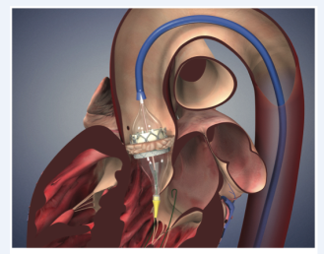
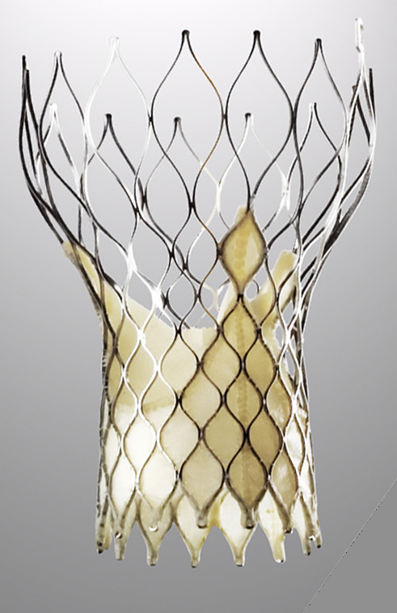

“TAVR: Transcatheter Treatment of Aortic Stenosis Comes of Age”
Muhammad Raza, MD, FACC, FSCAI, RPVI.
Interventional cardiologist
Director, Cardiac Cath Lab,
Crozer Chester Medical Center,
Upland, PA

Slide 2
Disclosure
Consultant and Proctor – Medtronic
Consultant – Abbott Vascular

Slide 3
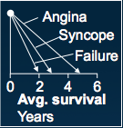
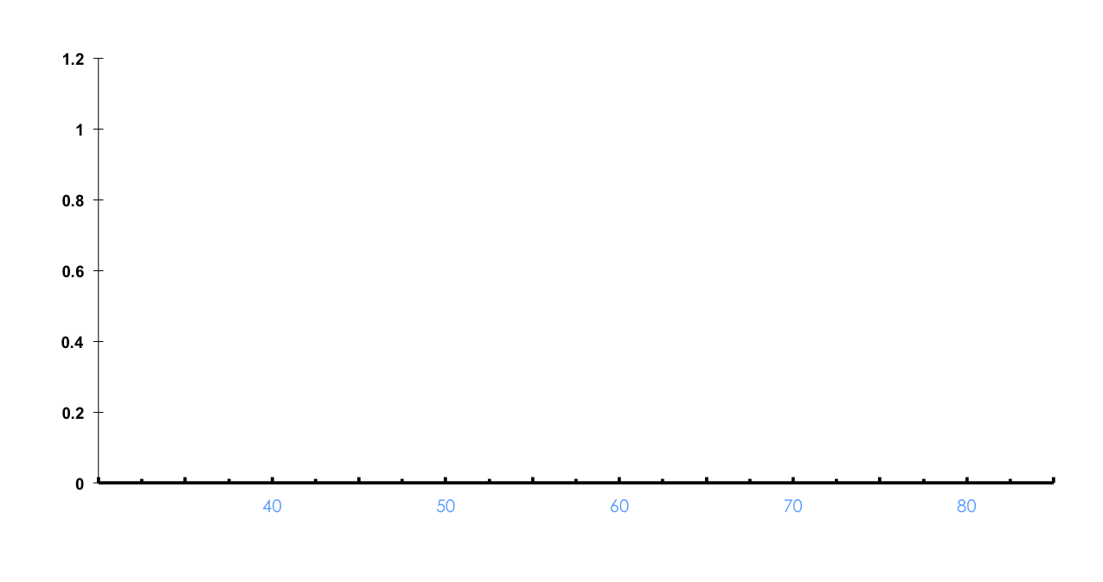
Natural History of Aortic Stenosis
100
Latent Period
Symptoms
80
Increasing obstruction,
myocardial overload
60
Survival (percent)
40
20
Average Age Death
0
40
50
60
70
80
Age (years)
from Ross and Braunwald, Circulation 1968;38:V-61
Notes:
Aortic stenosis typically indolent and gradually progressive early in course
Prognosis benign during latent period prior to onset of symptoms
However dramatic worsening of prognosis after development symptoms
Typically age 70’s - 80’s
Bicuspid age 5th or 6th decade

Slide 4

Therapeutic Options in AS
Medical therapy!
  AS = Mechanical problem = Mechanical solution
  No medical therapy effective in delaying progression or altering outcome of AS
Surgical therapy
Transcatheter therapy

Slide 5
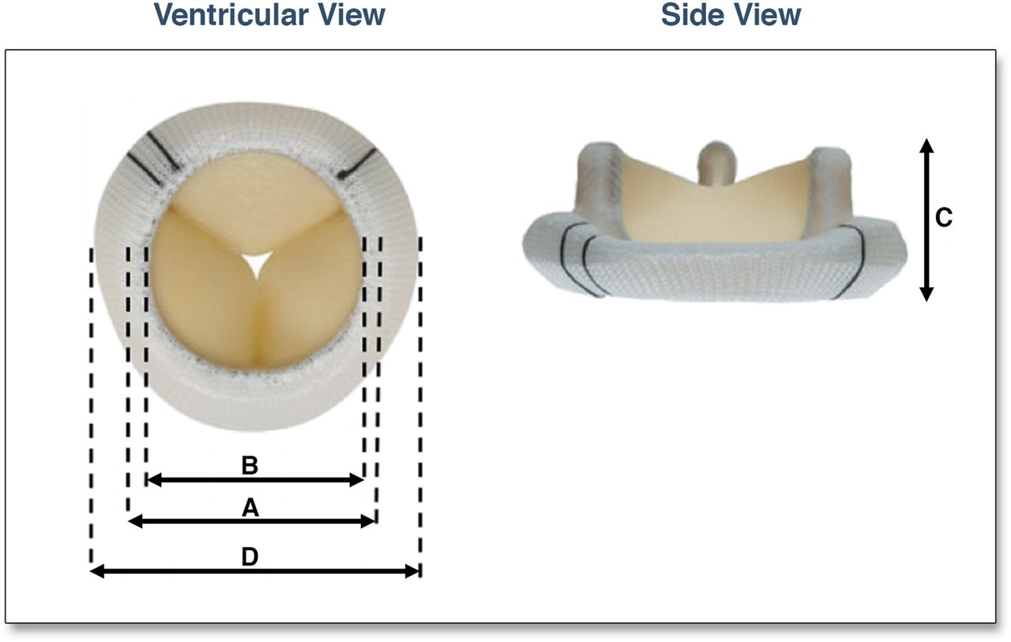
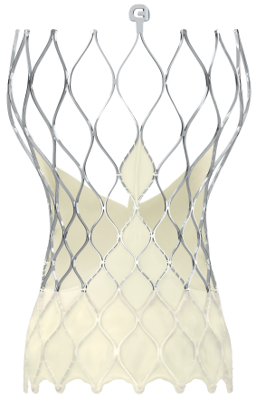
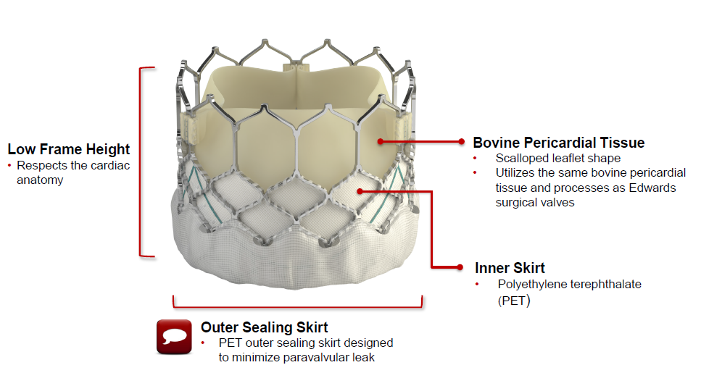

Slide 6
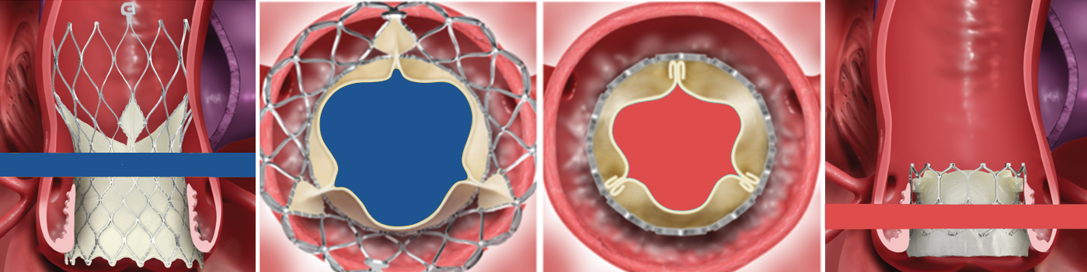
Hemodynamics Performance
TAVR System’s supra-annular valve function achieves larger EOAs and lower gradients than intra-annular TAV designs, lessening the risk of patient-prosthesis mismatch especially in smaller annulus patients. ¹
Evolut R Supra-Annular TAV
Intra-Annular TAV Design
Abdelghani, et al. JACC, 2018.
Notes:
Increase in EOA by quintile
17.7%
15.2%
14.5%
10.6%
34.0%

Slide 7
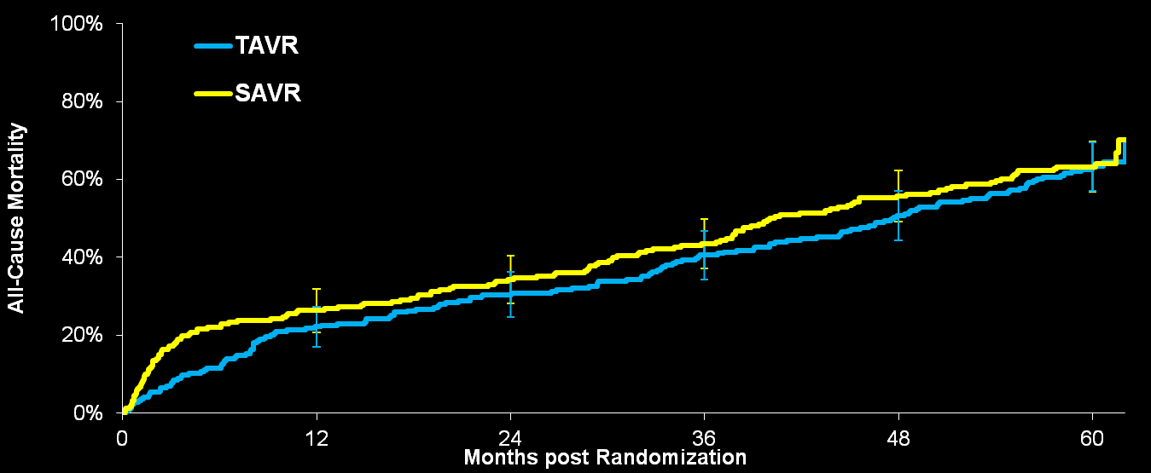
PARTNER 1 Trial – 5-Year Outcome
All-Cause Mortality
  HR [95% CI] =
  0.91 [0.72, 1.14]
  p (log rank) = 0.41
63.3%
63.3%
Error Bars Represent 95% Confidence Limits
No. at Risk
TAVR | 244 | 189 | 167 | 141 | 115 | 50
SAVR | 248 | 168 | 150 | 125 | 93 | 46

Slide 8
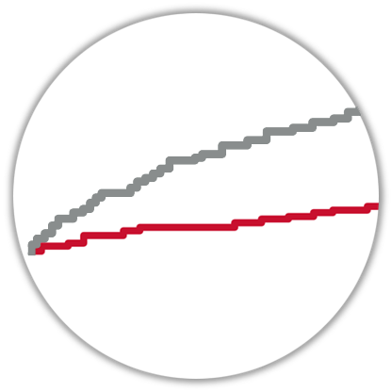
PARTNER 11 Trial
All-cause mortality*
40
Surgery (PIIA)
TAVR with SAPIEN 3 valve
30
All-cause mortality (%)
20
13.0%
10
4.0%
4.0%
7.4%
1.1%
0
1.1%
0
3
6
9
12
Months from procedure
Number at risk:
Surgery
944
859
836
808
795
SAPIEN 3 TAVR
1077
1043
1017
991
963
*The PARTNER II trial intermediate-risk cohort unadjusted clinical event rates.
Notes:
Here we see the unadjusted rates of all-cause mortality at 30 days and 1 year for the two groups.

Slide 9
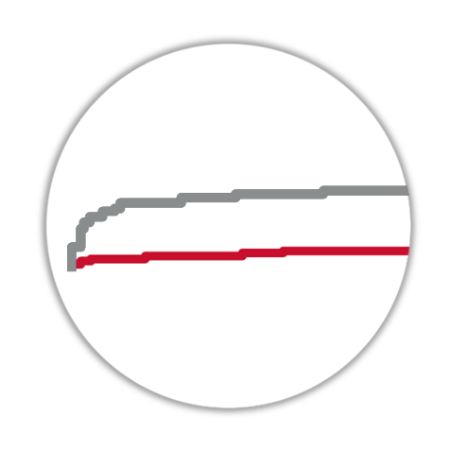
PARTNER 11 Trial
Disabling Stroke*
40
Surgery (PIIA)
TAVR with SAPIEN 3 valve
30
Disabling stroke (%)
20
4.4%
10
4.4%
5.9%
1.0%
2.3%
0
1.0%
0
3
6
9
12
Months from procedure
Number at risk:
Surgery
944
825
806
778
764
SAPIEN 3 TAVR
1077
1033
1008
884
953
*The PARTNER II trial intermediate-risk cohort unadjusted clinical event rates.
Notes:
Here we see the unadjusted rates of disabling stroke at 30 days and 1 year for the two groups.

Slide 10
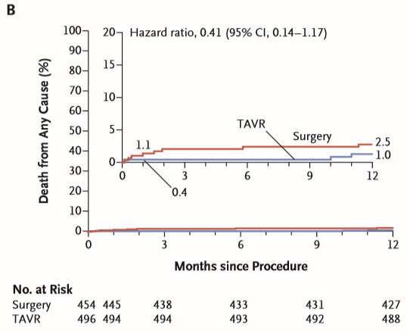
PARTNER 111 Trial
All-cause mortality

Slide 11
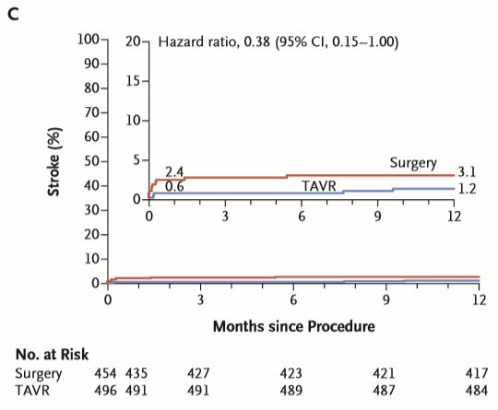
PARTNER 111 Trial
Disabling Stroke

Slide 12
TAVR is standard of care for majority of AS patients
The fact that two separate groups using two separate valves have come to very similar conclusions, this not only doubles the acceptability, but it quadruples it."
Eugene Braunwald, MD

Slide 13
Severity of PPM definition in the aortic Valve Position
Patient Prosthesis Mismatch
Severe
Moderate
Mild
Indexed EOA (cm²/m²)
0.65
0.85
EOA_{i} in obese (cm²/m²)
0.6
0.7
Kappetein, A. Pieter, et al. European heart journal 33.19 (2012): 2403-2418.

Slide 14
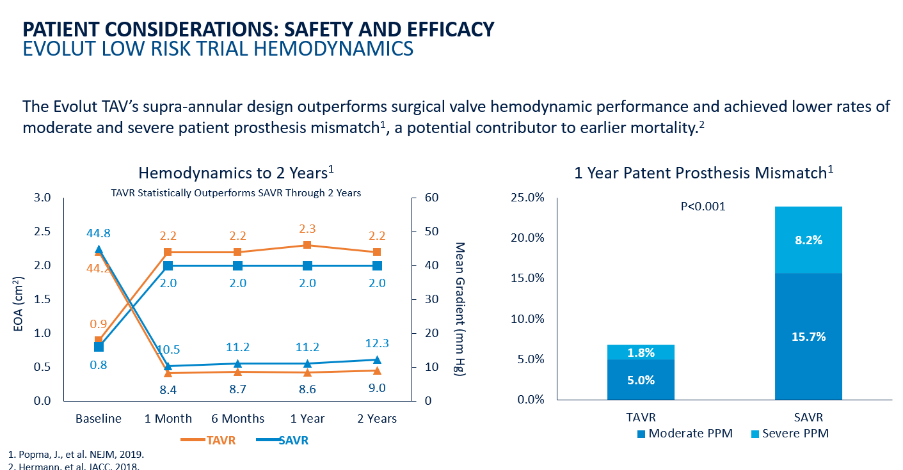
Patient Prosthesis Mismatch

Slide 15
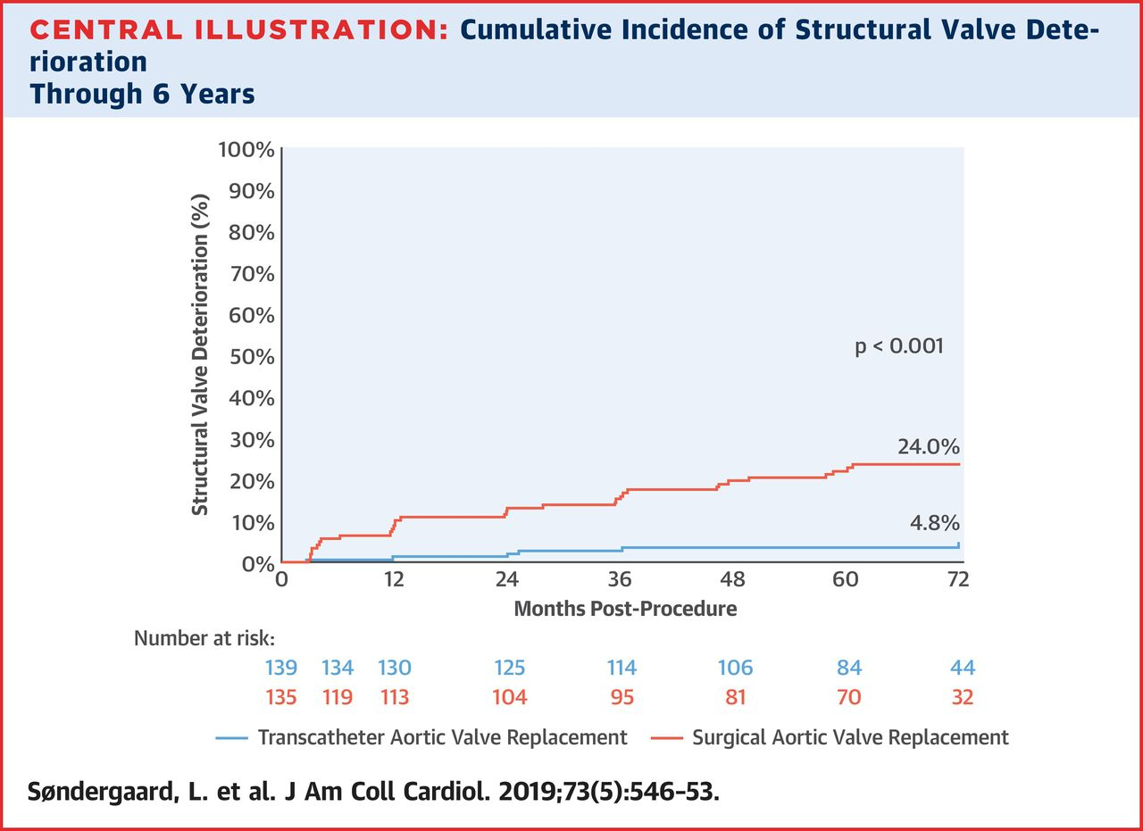
Structural Valve Degeneration

Slide 16
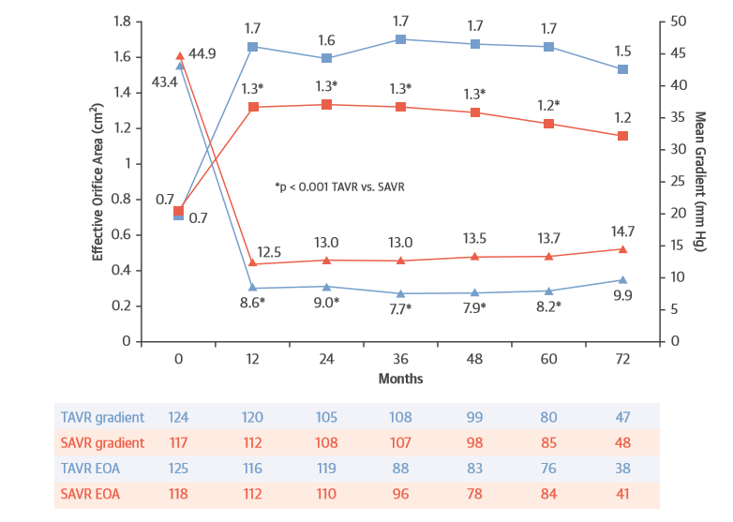
Structural Valve Degeneration

Slide 17
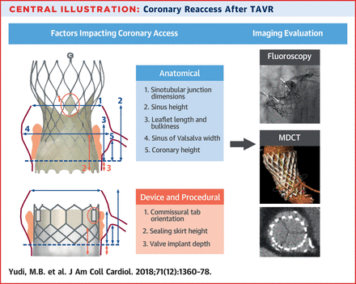
Coronary Access Post TAVR

Slide 18
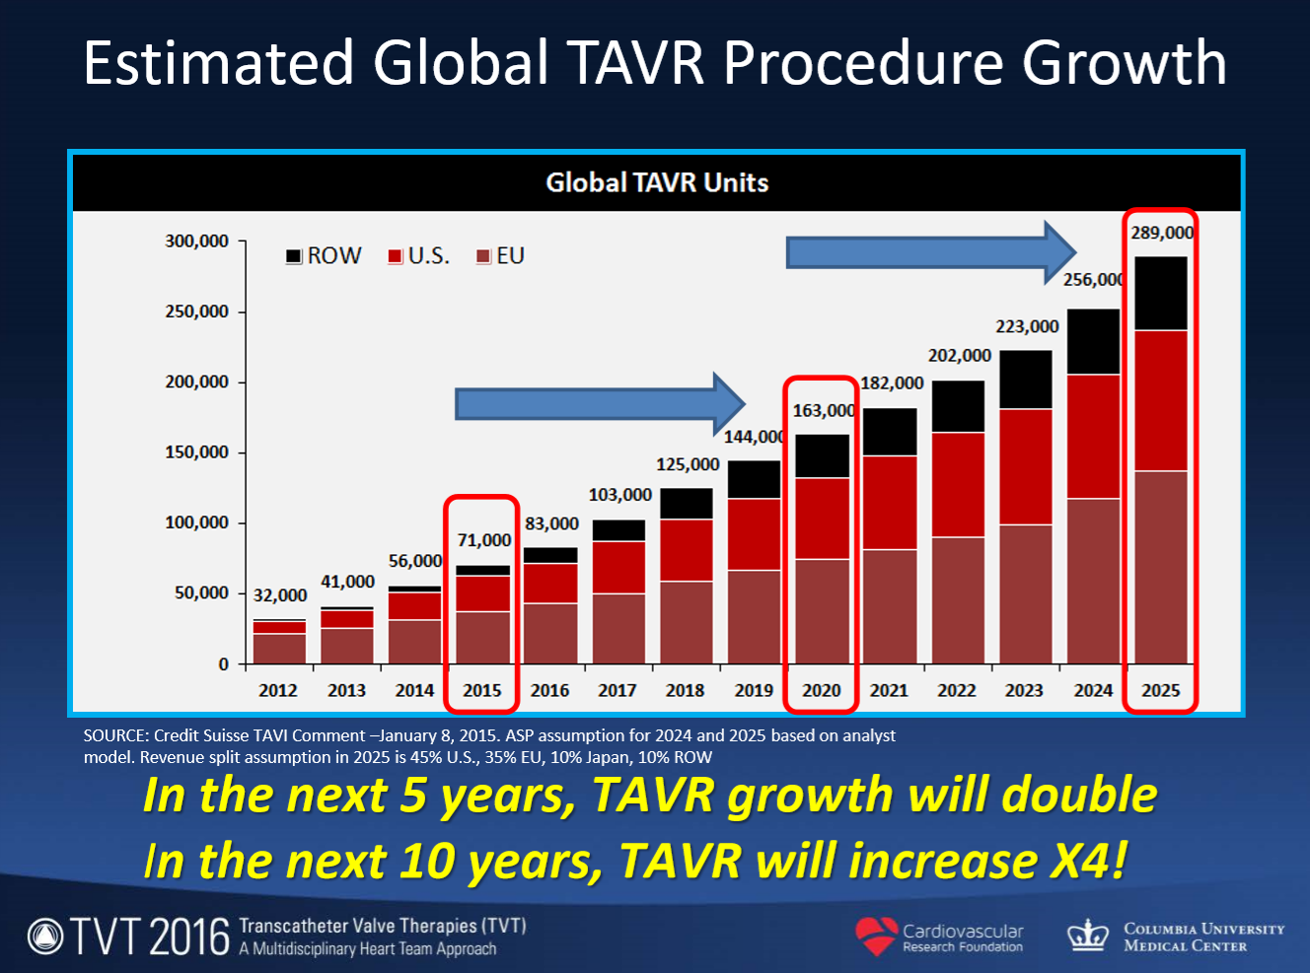

Slide 19
Natural History of Aortic Stenosis
100
Latent Period
Symptoms
80
Increasing obstruction,
myocardial overload
60
Survival (percent)
40
20
Average Age Death
0
40
50
60
70
80
Age (years)
from Ross and Braunwald, Circulation 1968;38:V-61
Notes:
Aortic stenosis typically indolent and gradually progressive early in course
Prognosis benign during latent period prior to onset of symptoms
However dramatic worsening of prognosis after development symptoms
Typically age 70’s - 80’s
Bicuspid age 5th or 6th decade

Slide 20
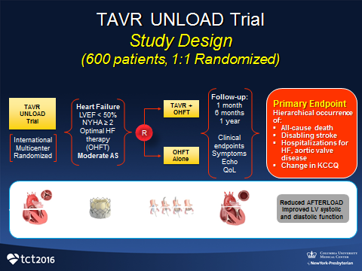
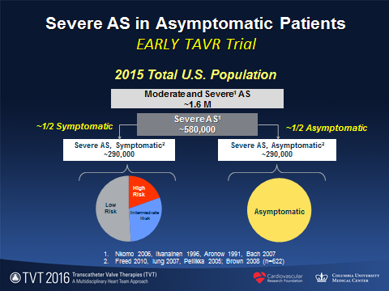
Earlier Intervention
Active Trials
There is interest in using TAVR to intervene earlier in the AS disease process to prevent inevitable myocardial damage and functional decline
TAVR UNLOAD
EARLY TAVR
TAVR will be compared to medical therapy in patients with moderate AS, symptoms of heart failure, and reduced EF
TAVR will be applied to asymptomatic patients with severe AS

Slide 21
Summary
TAVR is standard of care for patients with AS
Short Term Outcomes:
  Mortality
  Stroke
  Paravalvular Leak
  Access
  Permanent PaceMaker
Long-term Outcomes:
  Patient Prothesis Mismatch
  Durability
  Coronary Access
  TAVR in TAVR
Technology is going to continue to improve

Slide 22
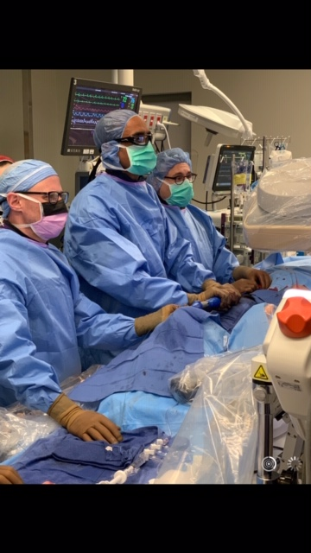
TAVR at CCMC

Slide 23
Thank you

