Slide 1
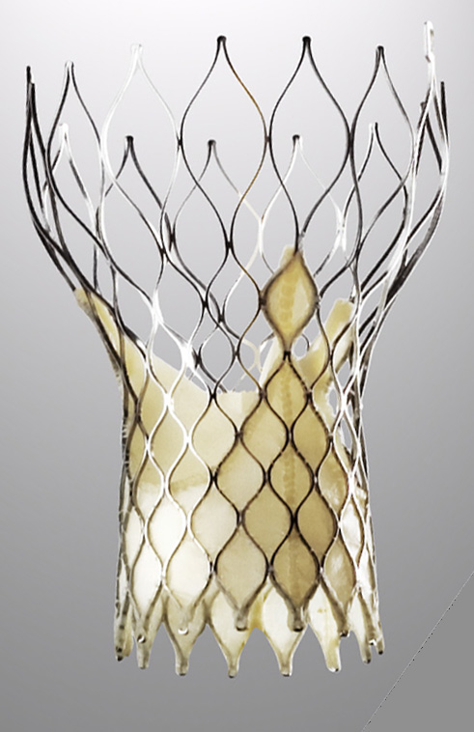
“Mitral Valve: To Clip or Not to Clip”
Muhammad Raza, MD, FACC, FSCAI, RPVI.
Interventional cardiologist
Director, Cardiac Cath Lab,
Crozer Chester Medical Center,
Upland, PA

Slide 2
Disclosure
Consultant and Proctor – Medtronic
Consultant – Abbott Vascular

Slide 3
Structural Heart Disease
Increases with Age
14
12
10
8
6
4
2
0
All valve disease
Mitral valve disease
Prevalence (%) of moderate to severe valve disease
Aortic valve disease
<45 45-54 55-64 65-74 >75
Age (years)
> 9.3% for ≥75 year olds (p<.0001)
Nkomo et al. Burden of Valvular Heart Diseases: A Population-based Study,
Lancet, 2006; 368: 1005-11.
Notes:
3
3

Slide 4
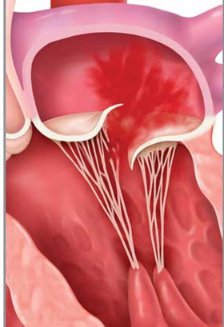
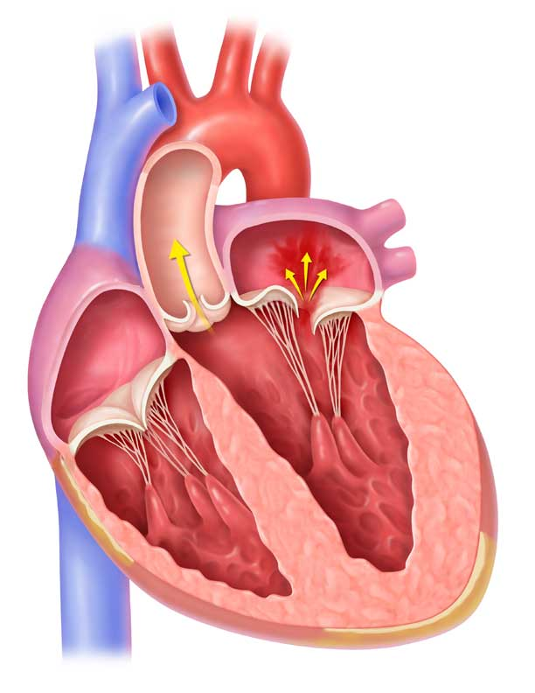
Classification of MR – 2 Types
Mitral Regurgitation Etiologies
Incompetent mitral valve closure
Systolic retrograde blood flow from the LV into the LA
Primary: Anatomic abnormality the mitral valve
Leaflets
Subvalvular apparatus
Chordae and papillary muscles
Secondary : LV dilation; often secondary to ischemic heart disease
Leads to mitral annular dilation
Incomplete coaptation of the mitral valve
Mayo Clinic (www.mayoclinic.com)

Slide 5
Pathophysiology of MR
Increasing Mitral Regurgitation
1 year mortality
up to
57%¹
Dilation of
Left Ventricle
Increase Load/Stress
Dysfunction
of Left Ventricle
Muscle Damage/Loss
¹ Cioffi G, et al. Functional mitral regurgitation predicts 1-year mortality in elderly patients with systolic chronic heart failure. European Journal of Heart Failure 2005 Dec;7(7):1112-7

Slide 6
MITRAL REGURGITATION
Untreated severe MR is associated with increased morbidity and mortality
What about therapy?

Slide 7
Asymptomatic DMR
Natural History
100
90
80
70
60
50
≤1 RF
95 ±2
MR ≥3 or EF <50%
≥2 RF
Survival %
Risk Factors
Age ≥50 yrs Atrial fibrillation
LA enlargement
Flail
Mild MR
70 ±5
55 ±9
0 2 4 6 8 10
Years after diagnosis
Avierinos JF, et al. Circulation 2002;106:1355

Slide 9
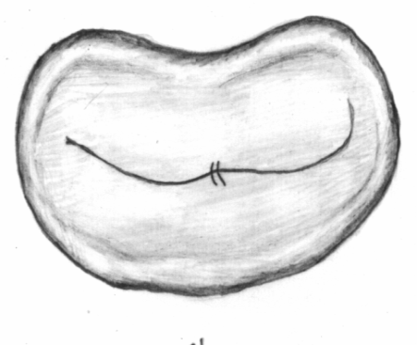
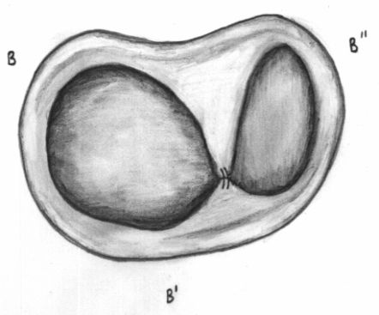
Double Orifice Repair Published Surgical Results
Introduced by Alfieri for degenerative and functional MR
>1000 repairs reported >10 y f/u
Equivalent to standard surgical repair for short and long term outcomes
No creation of stenosis of the orifice
Overall freedom from re-operation 90% @ 5yrs

Slide 10
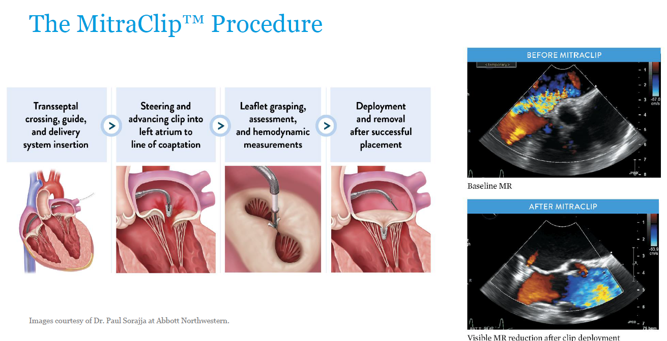

Slide 11
MitraClip® Experience
Transcatheter Mitral Repair
EVEREST I Feasibility (n=55)
EVEREST II Pivotal
Pre-Randomization (n=60)
HR Registry (n= 78)
Randomized (2:1 Clip to Surgery) (n= 279)
REALISM Registry
Continued Access (n=965)
Worldwide Commercial Use: >15,000 patients
Notes:
Flail mitral eclip in 88 yo

Slide 12
Transcatheter Mitral Repair
May be considered for prohibitive risk patients with primary MR and severe symptoms despite GDMT (class IIb)
ACC/AHA Guidelines – Primary MR
Notes:
Need to recreate these curves

Slide 13
See Important Safety Information Within. ©2019 Abbott. All rights reserved. AP2947499-US Rev A

Slide 14
The COAPT Trial
Cardiovascular Outcomes Assessment of the MitraClip Percutaneous Therapy for Heart Failure Patients with Functional Mitral Regurgitation
A parallel-controlled, open-label, multicenter trial in ~610 patients with heart failure and moderate-to-severe (3+) or severe (4+) secondary MR who remained symptomatic despite maximally-tolerated GDMT
Randomize 1:1*
MitraClip + GDMT
N=305
GDMT alone
N=305
*Stratified by cardiomyopathy etiology (ischemic vs. non-ischemic) and site
See Important Safety Information Within. ©2019 Abbott. All rights reserved. AP2947499-US Rev A

Slide 15
Primary Effectiveness Endpoint
All Hospitalizations for HF within 24 months
300
MitraClip + GDMT GDMT alone
283
in 151 pts
Cumulative
HF Hospitalizations (n)
250
200
150
160
in 92 pts
100
HR (95% CI] = 0.53 [0.40-0.70] P<0.001
6 9 12 15 18 21 24
Time After Randomization (Months)
50
0
0
3
No. at Risk:
Median [25%, 75%] FU
= 19.1 [11.9, 24.0] mos
MitraClip | 302 | 286 | 269 | 253 | 236 | 191 | 178 | 161 | 124
GDMT | 312 | 294 | 271 | 245 | 219 | 176 | 145 | 121 | 88
See Important Safety Information Within. ©2019 Abbott. All rights reserved. AP2947499-US Rev A

Slide 16
All-cause Mortality
100%
MitraClip + GDMT
GDMT alone
All-cause Mortality (%)
80%
HR [95% CI] = 0.62 [0.46-0.82] P<0.001
60%
NNT (24 mo) =
5.9 [95% CI 3.9, 11.7]
46.1%
40%
29.1%
20%
0%
6 9 12 15 18
Time After Randomization (Months)
0
3
21
24
No. at Risk:
MitraClip + GDMT | 302 | 286 | 269 | 253 | 236 | 191 | 178 | 161 | 124
GDMT alone | 312 | 294 | 271 | 245 | 219 | 176 | 145 | 121 | 88
See Important Safety Information Within. ©2019 Abbott. All rights reserved. AP2947499-US Rev A

Slide 17
Death or HF Hospitalization
100%
MitraClip + GDMT GDMT alone
HR [95% CI] = 0.57 [0.45-0.71] P<0.001
All-cause Mortality or HF Hospitalization (%)
80%
67.9%
60%
45.7%
40%
20%
NNT (24 mo) = 4.5 [95% CI 3.3, 7.2]
0%
9 12 15
Time After Randomization (Months)
0
3
6
18
21
24
No. at Risk:
MitraClip + GDMT | 302 | 264 | 238 | 215 | 194 | 154 | 145 | 126 | 97
GDMT alone | 312 | 244 | 205 | 174 | 153 | 117 | 90 | 75 | 55
See Important Safety Information Within. ©2019 Abbott. All rights reserved. AP2947499-US Rev A

Slide 18
Conclusions
In pts with HF and moderate-to-severe or severe secondary MR who remain symptomatic despite maximally-tolerated GDMT, transcatheter mitral leaflet approximation with the MitraClip:
Safe,
Provided durable reduction in MR,
Reduced the rate of HF hospitalizations,
Improved survival,
Quality-of-life and functional capacity during 24-month follow-up
See Important Safety Information Within. ©2019 Abbott. All rights reserved. AP2947499-US Rev A

Slide 19
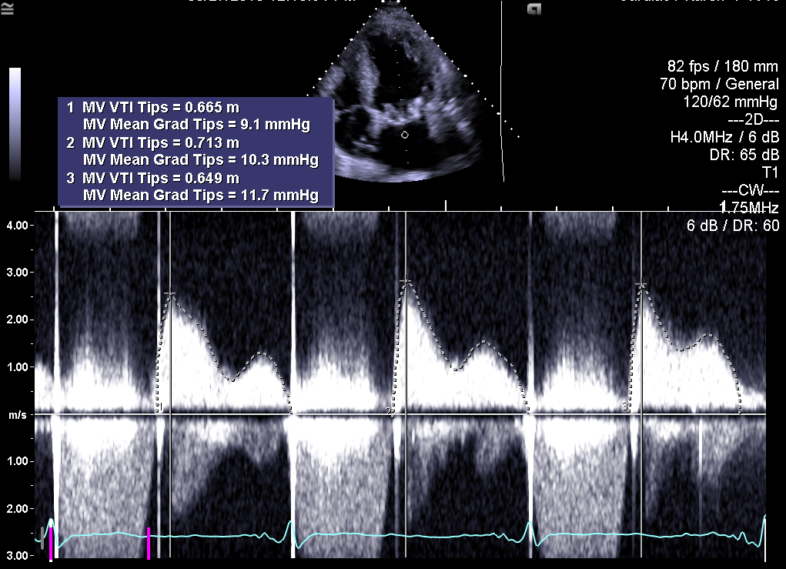
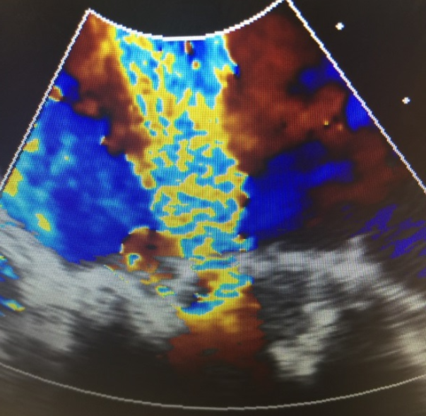
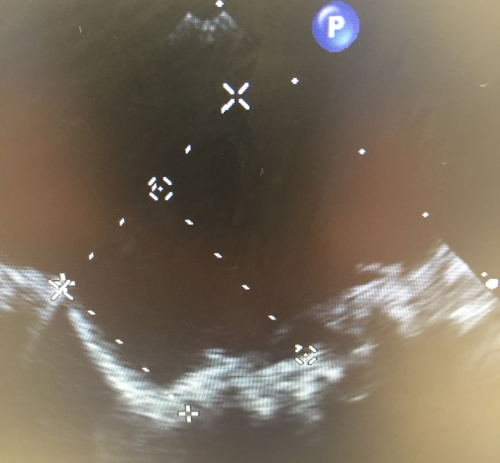
Severe Bioprosthetic MV Regurgitation
A
B
Transthoracic echocardiogram
Transesophageal echocardiogram
Moderate MR, mitral PG 32 mmHg, Mitral MG 12 mmHg, severe decreased global left ventricular systolic function, EF 25 %, mild AI, moderate TR, Peak PAP 41 mmHg
Severe MR, mitral MG 9.3 mmHg
Showed transeptal puncture site and height from MV

Slide 21
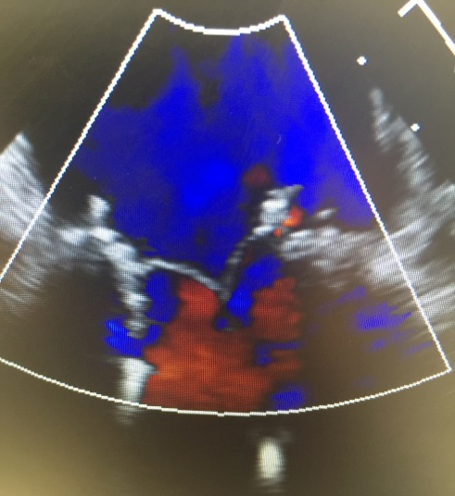
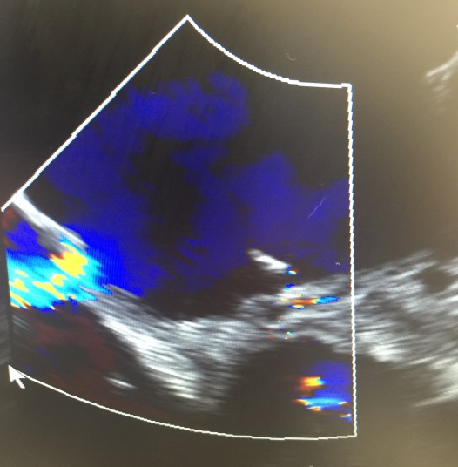
Final Results
A
B
C
D
Pre-TMVIV replacement TEE
Post-TMVIV replacement TEE
ASD from Septostomy on TEE
Post-ASD closure 3D TEE
Pre-procedural 2D TEE with color Doppler shows severe mitral regurgitation.
Post-procedural 2D TEE shows complete resolution of mitral regurgitation after deployment of the 26-mm BE valve.
Atrial septal defect from septostomy on TEE with left to right shunt on color Doppler.
3D TEE shows closure of atrial septal defect with 12 mm septal occluder.

Slide 22
TMVR

Slide 23
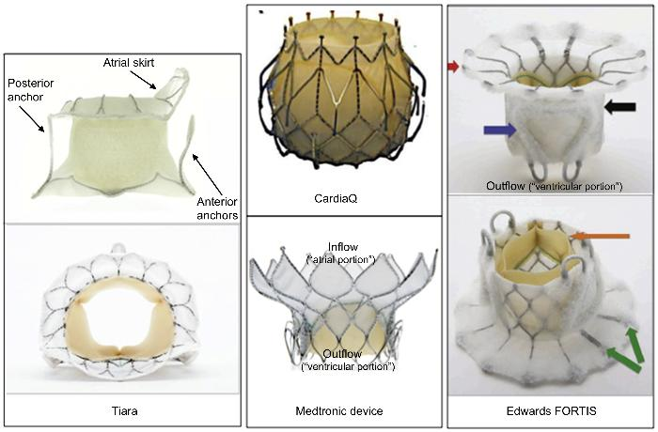
Transcatheter mitral valves of the future

Slide 25
Structural portfolio
TAVR
Mitral valve repair and replacement
Tricuspid valve repair and replacement
PFO/ASD closure
LAA closure procedure
PVL
VSD
All percutaneous

Slide 26
Thank you

