Slide 1
Chronic Kidney Disease and Cardiovascular Risk
Heather Mascio, DO

Slide 2
Introduction
Chronic Kidney Disease (CKD) affects around 14% people in the United States
Individuals with CKD are 10 times more likely to die of CV disease than the general population and dialysis dependent individuals are at even higher risk (around 50% of them will die of CV causes)
Cardiovascular disease (CVD) remains the leading cause of death across the spectrum of chronic kidney disease (CKD), including CKD not requiring dialysis and for patients requiring dialysis or kidney transplantation
As well as their high prevalence of traditional CAD risk factors, such as diabetes and hypertension, persons with CKD are also exposed to other nontraditional, uremia-related cardiovascular disease risk factors, including inflammation, oxidative stress, and abnormal calcium-phosphorus metabolism. CKD and end-stage kidney disease not only increase the risk of CAD, but they present with less typical symptoms that may be missed
44% patients with CKD G3a or higher who present with acute myocardial infarction (AMI) report chest, arm, shoulder, or neck pain compared with 72% of patients with preserved kidney function, but these patients are more likely be dyspneic (1). Similarly, 44% of AMI presentations among dialysis patients are characterized by chest pain, compared with 68% of non-dialysis patients(2)

Slide 3
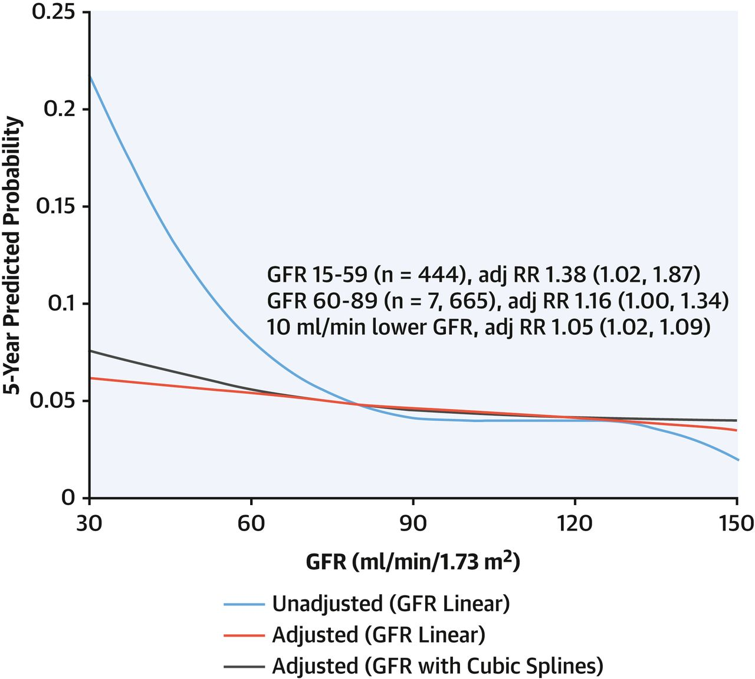
.
Cardiovascular disease (CVD) is the leading cause of morbidity and mortality among patients with CKD.
Even after adjustment for known CAD risk factors, including diabetes and hypertension, mortality risk progressively increases with worsening CKD
As glomerular filtration rate (GFR) declines below ∼60 to 75 ml/min/1.73 m², the probability of developing CAD increases linearly and patients with CKD stages G3a to G4 (15-60 ml/min/1.73 m²) have approximately double and triple the CVD mortality risk, respectively, relative to patients without CKD.
3. Chronic Kidney Disease Prognosis Consortium, Matsushita K., Ian der Velde M., et al.
Association of estimated glomerular filtration rate and albuminuria with all-cause and cardiovascular mortality in general population cohorts: a collaborative meta-analysis. Lancet 375:2073–2081
Notes:
Going back to CV Risk—as you can see in this figure

Slide 4
Notes:
First lets see if they meet criteria for CKD

Slide 5
Case Presentation
66 Year Old Caucasian Male with history of CKD stage 3 referred for worsening renal function over the past month post a cardiac catheterization done for SOB. He has a h/o and CAD first cardiac cath around 2000 . Cath showed a total occlusion of RCA 50% LAD lesion equipment broke and he was not intervened on. cardiology wants to cath again for stent but did blood work that showed worsening renal function. SCr prior to cath was 1.2mg/dl and post 1.6mg/dl . At that time his lisinopril was stopped. He continues to have DOE with moderate exercise
Vs: HR 65, BP 144/88
Current Medications: amlodipine 10mg, Toprol XL 50mg, atorvastatin 80mg , ASA 81mg, Plavix 75mg
Last Labs:
Scr 1.60, eGFR 44, Na 137, K 4.4, BG 126, BUN 34, CO2 22, Ca 9.7, BUN/creatine 21, Hgb 13.4, Hct 39.2, PLT 189
Ca 8.9, phos 5, PTH 100, hgb 11.5
LDL 131, TC 190, HDL 25
Question about proceeding with cardiac catheterization given CKD and presumed dye injury
Notes:
ALSO question about how I can optimize this patient and work on his CV risk factos

Slide 6
Risk Factors

Slide 7
Non Traditional Risk Factors-Anemia
Anemia: Strong association between anemia and cardiovascular complications.
Anemia is linked to LVH development, found in up to 74% of patients at the commencement of renal replacement therapy and is an independent predictor of consequent cardiac morbidity and mortality among patients with ESRD
Does Correcting Anemia help?
Cardiovascular Risk Reduction by Early Anemia Treatment with Epoetin Beta (CREATE) trial looked at patients in the earlier stages of CKD (3 and 4) to try and achieve levels of normal and low to normal hemoglobin (hb).
  The normal Hb group was found to have an improved overall health and quality of life.
  LVH was found in both groups to be stable-treating anemia did not have an effect on the LVH progression (7)
Notes:
As you have worsening CKD higher risk for developing anemia
Outcome: likely by treating the anemia no significant improvement in CV Risk—however we have proven that correcting to much with ESA /epogen >11.5 puts you ate risk for HTN And Stroke

Slide 8
Anemia Targets
Who Often Do We Test (Kidney Disease Improving Global Outcomes (KDIGO) Guidelines 2012)
Those with CKD and no evidence of Anemia: at least annually in patients with CKD 3 at least twice per year in patients with CKD 4–5ND at least every 3 months in patients with CKD 5HD and CKD 5PD
Those with CKD and Anemia (not on ESA): at least every 3 months in patients with CKD 3–5ND and at least monthly in patients with CKD 5HD
ESA indicated when hg < 10g/dL (after investigated reasons for the anemia-i.e rule out GI bleed)
Iron Therapy: Consider start when CKD patient is anemic and TSAT is <30% and ferritin is <500 ng/ml
  Trial can be 1-3 months oral iron every other day
  IV Iron deferred for failure to respond to oral Iron
Notes:
Frequency of when to test based on level of CKD

Slide 9
Non- Traditional Risk Factors-Calcium and Phosphate Metabolism
GFR levels decline, there is a decrease in serum calcium (Ca) levels while parathyroid hormone (PTH) and phosphate (phos) levels become elevated
An elevated level of serum phosphorus is highly prevalent in ESRD patients, and is a significant and independent risk factor of all cause and cardiovascular mortality
Underlying mechanism through which hyperphosphatemia and an increase in calcium-phosphate product leads to cardiovascular disease is not well established. One theory is that high phosphate levels exacerbate the atherosclerosis process by increased calcification and proliferation of smooth muscle (4)
Calcium-based binders have been shown in observational studies to be associated with arterial calcification.
Sevelamer (Renvela) is a non-absorbable agent that does not contain calcium and has been shown in a significant number of trials to be effective in lowering serum phosphate levels. It has also been shown to have beneficial effects on vascular calcification progression (6)
Notes:
205 patients on hemodialysis who had baseline electronbeamtomography (EBT) testing to evaluate both vascular/valvular calcification. The incidence and degree ofvalvular calcification was found to be remarkable with45% of subjects having calcification of the mitral valve,and 34% having calcification of the aortic valve, comparedwith 3%-5% prevalence in the general population.More than 70% of patients had coronary artery calcificationsignificant enough to be linked with ahigh risk of future MI and coronary death in the general population[
Based on trend if phos increased consider treatment, same with PTH
On HD goal <5.5 and PTH 2-9x ULN

Slide 10
Practice Guidelines
Level Check per KDIGO :
  CKD G3a-G3b: for serum calcium and phosphate, every 6-12 months; and for PTH, based on baseline level and CKD progression
  In CKD G4: for serum calcium and phosphate, every 3-6 months; and for PTH, every 6-12 months.
  In CKD G5, including G5D: for serum calcium and phosphate, every 1-3 months; and for PTH, every 3-6 months
Who Do We Treat:
  Calcium: goal to keep in normal Range
  Phosphorus: watch trend and consider phosphate lowering if consistently elevated (most would say <4.5)
  PTH: controversial unclear what levels are appropriate—watch trend
    On Dialysis up to 2-9 times ULN
Notes:
On HD: quarterly for PTH if at goal (500-600)
Phos treated binder-not calcium based and PTH calcitriol (synthetic D3) and on dialysis sensipar (calcimimetic agent)

Slide 11
Non- Traditional Risk Factors-Albuminuria
Albuminuria a marker of renal damage, it is also an independent risk factor for CVD and leads to an increase in all cause mortality in diabetics, those with hypertension, and in relatively unselected or general populations
Heart Outcomes Evaluation (HOPE) trial results showed that in those with or without diabetes, albuminuria of any level can be a risk factor for CVD events.
  It also found microalbuminuria to result in an increased risk of future stroke, myocardial infarctions and death in both diabetic and non-diabetics without CKD.
  For every increase in the albumin:creatinine ratio (ACR) by 0.4 mg/mmol, there was a 5.9%increase in the HR hazard ratio (HR) of major CVD outcomes (5)
Pathophysiology behind how microalbuminuria contributes to CVD remains to be fully understood, however studies suggest that microalbuminuria might reflect endothelial dysfunction (4)
Who should we check albuminuria: Of course check in diabetics and HTN patients annually
Who else to Screen? Those at increased Risk for CKD- Cardiovascular disease, older age, history of low birth weight, obesity, and a family history of CKD
Notes:
Less significant than traditional RF-presence of increased oxidativestress and acute-phase inflammation in early andadvanced stages of CKD (3-5) compared to healthy subjects.Renal insufficiency is associated with increased levelsof several different inflammatory and pro-coagulant
biomarkers, the main two being CRP and IL-6, which a strong predictors of all-cause mortality and cardiovascularoutcomes in ESRD[103-105].

Slide 12
Nephrol Dial Transplant (2018) 33: 23–25 doi: 10.1093/ndt/gfx329 Advance Access publication 9 November 2017

Slide 13
Management of Dyslipidemia
The benefits of lowering low-density lipoprotein (LDL) cholesterol with HMG-CoA reductase inhibitors (statins) are established in patients without renal dysfunction so how about those with CKD?
The Study of Heart and Renal Protection (SHARP) trial clearly demonstrated a benefit of lowering LDL cholesterol with simvastatin/ezetimibe (fixed dose) compared with placebo as primary prevention of atherosclerotic vascular events in patients with CKD not requiring dialysis [3].
By contrast, two large RCTs in dialysis patients, 4D and AURORA, showed no demonstrable benefit of statin therapy (atorvastatin in 4D, rosuvastatin in AURORA) in dialysis patients [4, 5].
  Both studies did show statin therapy lowered LDL but no effect on outcome of CV death/MI/stroke
The ALERT trial of lipid lowering with fluvastatin to prevent cardiovascular events in renal transplant recipients showed that statin therapy was associated with a reduction in non-fatal myocardial infarction and cardiac deaths [6].
Notes:
SHARP >9000 participants with CKD, 30% dialysis dependent—reduction risk in those not on dialysis and not significant on dialysisno ecessive risk for myopathy or hepatis
Summary: good evidence in statin use in CKD patient but not on dialysis-on HD no lowered risk

Slide 14
KDIGO Practice Guidelines on Lipids:
In adults aged >50 years with CKD and eGFR < 60 ml/min/1.73m2 (all stages of CKD) we recommend treatment with a statin.
In adults aged 18–49 years with CKD but not treated with chronic dialysis or kidney transplantation, we suggest statin treatment in people with one or more of the following (2A):
  known coronary disease (myocardial infarction or coronary revascularization
  Diabetes mellitus
  Prior ischemic stroke
  Estimated 10-year incidence of coronary death or non-fatal myocardial infarction >10%
All Transplant Recipients should be on a statin

Slide 15
Targeting Blood Pressure
Until recently most guidelines including KDIGO in 2012 recommended aiming for target systolic BP of <140mmHg and<130mmHg with proteinuria with preferential use of renin angiotensin system inhibition in the presence of significant proteinuria.
Only 2 trials looked at effects of blood pressure target on primary CV endpoints: The Action to Control Cardiovascular Risk in Diabetes (ACCORD) and the Systolic Blood Pressure Intervention Trial (SPRINT)
  ACCORD excluded advanced CKD (only SCr <1.5mg/dL) but 36% had albuminuria (9)
  Results in diabetics lower BP did not reduce CV events
SPRINT: Included 2,646 non-dialysis CKD (28% of the study participants GFR ranged from 20-60ml/min) compared systolic target of 120mmHg to 140 mmHg
  Results: lower BP group did have less CV events and all cause mortality
  Trend for increased adverse events: AKI, hyperkalemia, increased rate of eGFR decline (10)
Limited data in CKD5D/on Dialysis increased lability likely worse prognosis
  pre-dialysis <120 mmHg or >180 mmHg
Notes:
Gist 2 main studies in CKD-discordant results but with of SPRINT: lower probably better, watch, labs, and watch for hypotension/symptoms

Slide 16
Anti-HTN Medication Classes
Evidence Favors use of Angiotensin converting enzymes inhibitors (ACEi ) or angiotensin receptor blockers (ARBs) for improvement in renal outcomes especially in those with albuminuria
  Also has been showed in most studies to decreased CV events in non dialysis dependent CKD
  Trial in CKD 5D/on dialysis are inconclusive but favor their use
Considerations: As much as I love ACEi and ARB must monitor for hyperkalemia and once eGFR starts to decline < 20ml/min benefit may wane and eGFR could improve with stopping the medications
  Newer medications: Veltassa and Lokelma can be used as K + lowering agents to continue use of these medications
Multiple Trials have looked at different classes of anti-HTN medications ( some diabetic, some with CAD) even including those with albuminuria or eGFR <60 ml/min/1.73m2 most did not have a CKD subgroup---there is no data to support one class over another
  Closest Trial –ALLHAT (anti-HTN and lipid lowering treatment to prevent heart attack Trial showed no difference in CV events with chlorthalidone, amlodipine, and lisinopril (8)
Notes:
RENAAL (the reduction in endpoints in NIDDM with Antiogension II antagonist losartan failed to show that losartan vs placebo showed decreased CV eendpoints but did reduced CHF admissions

Slide 17
Life Style Changes
Diabetes: briefly -Goal A1C <7 (no trials that look specifically at CV reduction in diabetics with NDD-CKD or CKD 5D)
  At this level of A1c have seen slowing of progression of albuminuria, doubling of creatinine, and worsening of diabetic retinopathy
Smoking Cessation: numerous observational studies that show increased risk inf NDD-CKD and former smokers have lower risk of CV events
Weight Loss :no prospective studies in NDD-CKD however higher risk for secondary FSGS/hyperfiltration and proteinuria
Exercise: moderate intensity exercise 4-5x/week 30+ minutes

Slide 18
Going back to Case Presentation
Question about risk for Contrast nephropathy: multiple risk calculators (include age, DM, CHF, hct, hypotension)
Contrast Injury Defined as: increase in creatinine of >25% or >0.5 mg/dL (>44 µmol/L) in pre-PCI serum creatinine at 48 hours after PCI.
In this case he has low-moderate risk: injury of <10% and low risk of needing dialysis <0.5%
Ways to modify risk in general: hold metformin 48H before and until lab check at 48—72H, if on diuretic would hold on day of procedure
Ideally if eGFR <40 ml/min get at least 3cc/kg/NS For 1H before cath and 1cc/kg/h for 6H after catheterization
Need to check BMP at 48-72H to look for contrast injury

Slide 19
More Recent Advances-SGLT 2 Inhibitors
Empagliflozin(Jardiance)
Located in the S1 segment of the proximal tubule, SGLT2 reabsorbs 90% of the filtered plasma glucose; therefore, its blockade increases urinary glucose excretion, especially in hyperglycemic conditions.
Two recent phase 3 RCTs, EMPAREG and CANVAS, evaluated two drugs in this class, empagliflozin and canagliflozin.
In EMPAREG more than 7,000 patients were randomized to empagliflozin or placebo on background standard therapy, including more than 15% patients with eGFR between 30-60 mL/min/1.73 m² (patients with CKD stage 4 or 5 were excluded).
After a median follow-up of 3.1 years, randomization to active treatment reduced the composite of cardiovascular death, MI or stroke by 14%, death by 32% and cardiovascular death by 38%, with consistent signals for those with eGFR <60 mL/min/1.73 m².
A significant 35% reduction in hospitalization for HF was described.
Potential Adverse Events: empagliflozin increased the rate of genital infections but not that of urinary infections.

Slide 20
CANVAS Trial-Canagliflozin (Invokana)
In patients with type 2 diabetes and established CVD or multiple CV risk factors, canagliflozin achieved 14% reduction in the primary composite endpoint of death from cardiovascular causes, nonfatal MI, or nonfatal stroke (HR 0.86; 95% CI 0.75 to 0.97; p<0.001 for noninferiority; p=0.02 for superiority) and a significant 33% reduction in hospitalization due to HF in the CANVAS program.
In the subset of subjects with eGFR between 30 and 60 mL/min/1.73 m² the reduction in the primary endpoint was even more pronounced (HR 0.70; 95% CI 0.55 to 0.90).
In terms of renal endpoints, the CANVAS program noted that active treatment resulted in a decrease in: 1) the progression to albuminuria; 2) the composite of 40% reduction in eGFR, renal replacement therapy, or renal death; and 3) regression of albuminuria.

Slide 21
DECLARE-TIMIT 58 Trial with Dapagliflozin (Farxiga)
Renal outcomes with the SGLT2 inhibitor dapagliflozin in the DECLARE–TIMI 58 cardiovascular outcomes trial, which included patients with type 2 diabetes both with and without established atherosclerotic cardiovascular disease and mostly with preserved renal function. (11)
Most had normal renal function: 47.6%) had an eGFR of at least 90 mL/min per 1·73 m ², 45.1% had an eGFR of 60 to less than 90 mL/min per 1·73 m ², and 7.4% had an eGFR of less than 60 mL/min per 1·73 m ² at baseline
Cardio-Renal Endpoints: sustained decline of at least 40% in estimated glomerular filtration rate [eGFR] to less than 60 mL/min per 1·73m ², end-stage renal disease (defined as dialysis for at least 90 days, kidney transplantation, or confirmed sustained eGFR <15mL/min per 1·73 m ²), or death from renal or cardiovascular causes
Results: identified a 46% reduction in sustained decline in eGFR by at least 40% to less than 60 mL/min per 1·73 m ² (120 [1·4% vs 221 [2·6%]; HR 0·54 [95% CI 0·43–0·67]; p<0·0001) in the dapa group
  The risk of end-stage renal disease or renal death was lower in the dapagliflozin group than in the placebo group (11 [0·1%] vs 27 [0·3%]; HR 0·41 [95% CI 0·20–0·82]; p=0·012).

Slide 22
Any Questions?

Slide 23
References
REFERENCES
Sosnov J., et al (2006) Differential symptoms of acute myocardial infarction in patients with kidney disease: a community-wide perspective. Am J Kidney Dis 47:378–384
2. Herzog C.A., et al Blaney M.
(2007) Clinical characteristics of dialysis patients with acute myocardial infarction in the United States: a collaborative project of the United States Renal Data System and the National Registry of Myocardial Infarction. Circulation 116:1465–1472.
3.Chronic Kidney Disease and Coronary Artery Disease Mark J. Sarnak et al. Journal of the American College of Cardiology Volume 74, Issue 14, October 2019
4. Alani et Al. World J Nephrol 2014 November 6; 3(4): 156-168
5. Gerstein HC et al. Albuminuria and risk of cardiovascular events,death, and heart failure in diabetic and nondiabetic individuals.JAMA 2001; 286: 421-426
6. Goodman WG et al. Coronary-artery calcification in young adults with end-stage renal disease who are undergoing dialysis.N Engl J Med 2000; 342: 1478-1483
7. Drüeke Tb at al. Normalization of hemoglobin level in patients with chronic kidney diseaseand anemia. N Engl J Med 2006; 355: 2071-2084
8. ALLHAT Officers and Coordinators for the ALLHAT Collaborative Research Group. Major outcomes in high-risk hypertensive patients randomized to angiotensin-converting enzyme inhibitor or calcium channel blocker vs diuretic: the Antihypertensive and Lipid-Lowering Treatment to Prevent Heart Attack Trial (ALLHAT). JAMA 2002;288:2981-2997
9. Margolis KL, O’Connor PJ, Morgan TM, et al. Outcomes of combined cardiovascular risk factor management strategies in type 2 diabetes: the ACCORD randomized trial. Diabetes Care 2014;37:1721-1728
10. A Randomized Trial of Intensive versus Standard Blood-Pressure Control. N Engl J Med 2015; 373:2103-2116
11. Effects of dapagliflozin on development and progression of kidney disease in patients with type 2 diabetes: an analysis from the DECLARE–TIMI 58 randomised trialVOLUME 7, ISSUE 8, P606-617, AUGUST 01, 2019
12. Canagliflozin and Cardiovascular and Renal Events in Type 2 Diabetes. August 17, 2017N Engl J Med 2017; 377:644-657
13. Empagliflozin, Cardiovascular Outcomes, and Mortality in Type 2 Diabetes. November 26, 2015N Engl J Med 2015; 373:2117-2128

