Slide 1
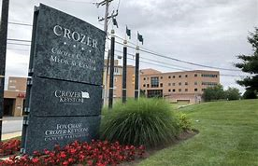
Structural Heart Program
The Next Decade in Cardiac Care

Slide 2
Crozer Keystone Health System Heart and Vascular Care
Cardiovascular Service Line
  Cardiology
  Cardiothoracic Surgery
  Electrophysiology
  Interventional Cardiology
  Cardio-Oncology
  Vascular Surgery
  Cardiac Rehabilitation
  Structural Heart Program

Slide 3
Crozer Keystone Health System Structural Heart Program Team
Multidisciplinary Heart Team Approach
  Collaboration between primary care physicians, referring physicians, cardiology, interventional cardiology and CT surgery
  Coordinated care discussed at weekly heart team meeting, communication with specialists & primary care physicians
  New Programs include TAVR and WATCHMAN

Slide 4
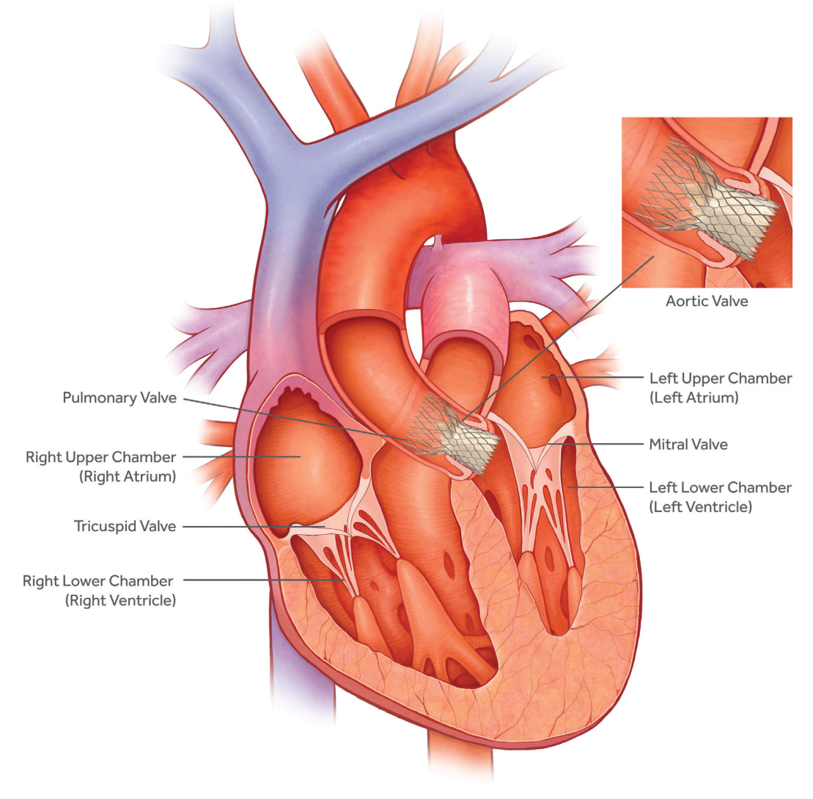
Transcatheter Aortic Valve Replacement (TAVR)

Slide 5
Transcatheter Aortic Valve Replacement (TAVR)
  Transcatheter Aortic Valve Replacement (TAVR)
    Procedure treats aortic stenosis – a progressive, life threatening disease
    Less invasive, shorter hospital stay
    Now offered closer to home at CCMC
    Crozer Chester Medical Center performed the first TAVR Procedures in Delaware County in November, 2019

Slide 6
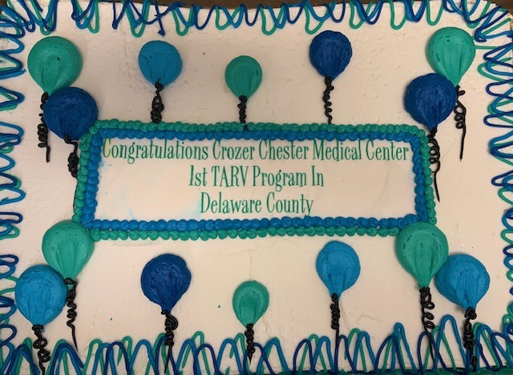
TAVR TUESDAY

Slide 7
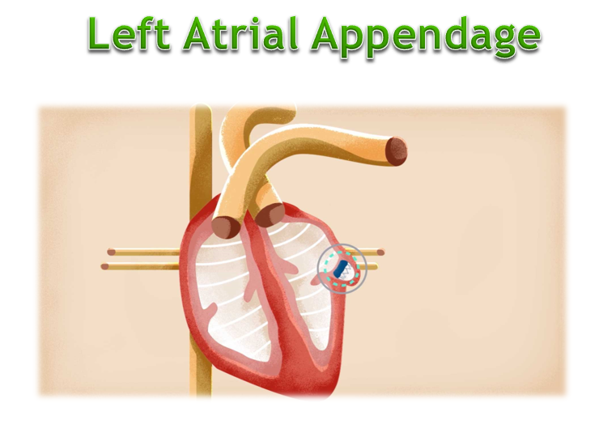
WATCHMAN Device

Slide 8
WATCHMAN Device
What is the Watchman Device?
  The WATCHMAN Device reduces the risk of stroke by closing off the left atrial appendage, which is known to be the main source of blood clots in patients with atrial fibrillation
  Indicated to reduce the risk of thromboembolism from the left atrial appendage in patients with non-valvular atrial fibrillation.
  First cases planned for March, 2020 at Crozer Chester Medical Center

Slide 9
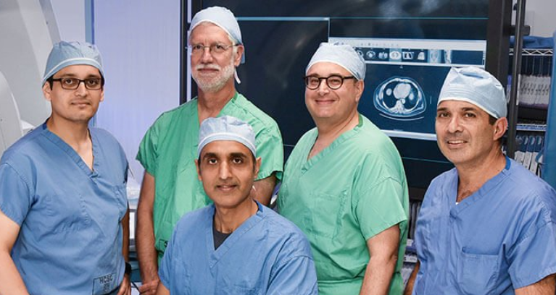
CKHS Structural Heart Team

