Slide 1
Emergency Medicine and Acute Coronary Syndrome
Avoiding Misses and thinking about MACE

Slide 2
Richard J. Hamilton MD FAAEM, FACMT, FACEP
Chair, Department of Emergency Medicine
Crozer Keystone Health System
Professor and Chair
Department of Emergency Medicine
Drexel University College of Medicine
Regional Associate Dean for Crozer Keystone Health System

Slide 3
ECGs and Emergency Medicine
EM Physicians read about 25 ECGs a day
  ECGs done at triage and immediately handed to a physician to make sure we have no misses
  Reasons:
    Syncope
    Chest pain
    Shortness of breath
    Weakness
    Cough
    Electrolyte abnormalities

Slide 4
ECGs and Emergency Medicine
Need to find the classic STEMI’s
On the lookout for STEMI equivalents
Always on guard for hyperkalemia (the syphilis of ECGs) and LVH as well as the problems with LBBB
Need to get the other patients on the right pathway (mini-rule out, observation, inpatient, cardiology, etc) and avoid a MACE at 30 days

Slide 5

STEMI – yes or no?
Cath Lab activation – yes or no?
New ST-segment elevation at the J point in 2 contiguous leads with the cutoff point as greater than 0.1 mV in all leads other than V2 or V3
  Women all ages: V2-V3 the cutoff point greater than 0.15 mV
  Men > 40: V2-V3 the cutoff point is greater than 0.2 mV
  Men < 40: V2-V3 the cutoff point greater than 0.25

Slide 6
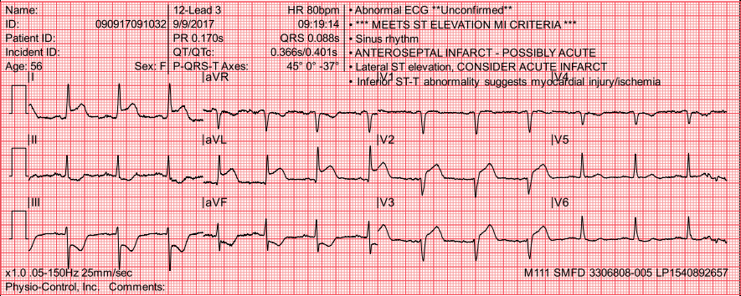
… or just count the asterisks!!! ***+*** = STEMI

Slide 7
But what about the STEMI equivalents
deWinter T waves
Hyperacute T wave
Wellens Type A and B
Shark Fin waves
LBBB with Sgarbossa criteria
Posterior STEMI
AVR

Slide 8
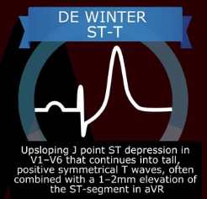
deWinter ST-T Wave
Indicative of proximal LAD occlusion in 2% of patients with anterior myocardial infarction
Do not evolve

Slide 10
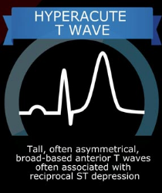
Hyperacute T Waves
hyperacute T wave is an abnormal T-wave morphology encountered in the earliest phase of ST-segment elevation acute myocardial infarction

Slide 13
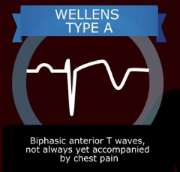
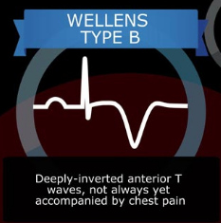
Wellens’ sign – warning for critical stenosis of LAD
Deeply-inverted or biphasic T waves in V2-3 (may extend to V1-6)
Isoelectric or minimally-elevated ST segment (< 1mm)
No precordial Q waves
Preserved precordial R wave progression
Recent history of angina
ECG pattern present in pain-free state
Normal or slightly elevated serum cardiac markers

Slide 14
Shark Fin Waves

Slide 15
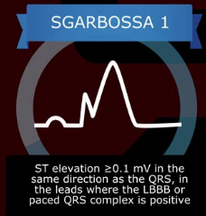
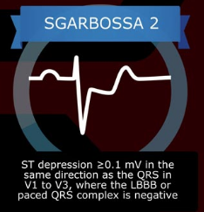
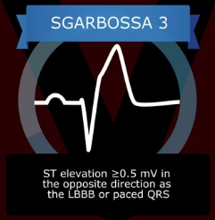
Sgarbossa criteria for LBBB
ST deviation that is
≥0.1 mV in the same direction as the QRS
OR ST/S ratio ≥ 25%

Slide 16
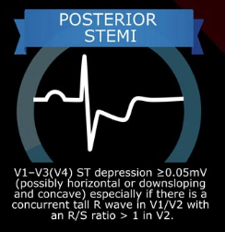
Posterior STEMI
Isolated posterior MI is less common (3-11% of infarcts).
Posterior extension of an inferior or lateral infarct implies a much larger area of myocardial damage, with an increased risk of left ventricular dysfunction and death.
Isolated posterior infarction is an indication for emergent coronary reperfusion.
Confused for NTEMI

Slide 17
Isolated Posterior MI

Slide 18
aVR

Slide 19
Isolated elevation in AVR as a STEMI equivalent
Widespread horizontal ST depression, most prominent in leads I, II and V4-6
ST elevation in aVR ≥ 1mm
ST elevation in aVR ≥ V1
Indicative of left main coronary artery occlusion
… also can be
Proximal left anterior descending artery (LAD) occlusion
Severe triple-vessel disease (3VD)
Diffuse subendocardial ischaemia – e.g. due to O2 supply/demand mismatch after resuscitation

Slide 20
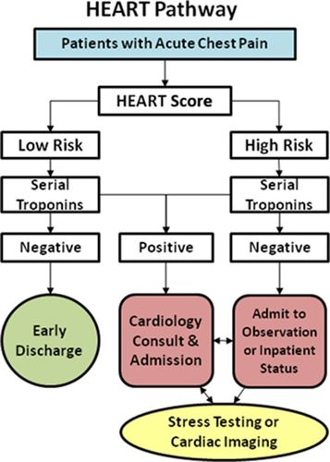

© 2015 American Heart Association, Inc.
Simon A. Mahler. Circulation: Cardiovascular Quality and Outcomes. The HEART Pathway Randomized Trial, Volume: 8, Issue: 2, Pages: 195-203, DOI: (10.1161/CIRCOUTCOMES.114.001384)
Notes:
HISTORY – ECG – AGE –RISK FACTORS-TROPONIN

Slide 21
The HEART SCORE and the HEART PATHWAY
Compared with usual care, use of the HEART Pathway
  decreased objective cardiac testing at 30 days by 12.1% (68.8% versus 56.7%; P=0.048)
  decreased length of stay by 12 hours (9.9 versus 21.9 hours; P=0.013)
  increased early discharges by 21.3% (39.7% versus 18.4%; P<0.001).
  No patients identified for early discharge had MACE major adverse cardiac events within 30 days.
Helps get Emergency Medicine, Admitting Physicians, and Cardiology Consultants on the same pathway

Slide 22
