Slide 1
Atrial Fibrillation is a Prevalent and Growing Condition and a Leading Cause of Stroke
5X
increased risk of stroke for AF patients²
12M
5M
AF
1 in 5 strokes occur in patients with AF³
‘15 ‘20 ‘30 ’40 ‘50
~5M
people with AF in U.S., expected to more than double by 2050¹
47% of AF patients experiencing a stroke will suffer a second stroke within 6 months⁴
Go AS. et al, Heart Disease and Stroke Statistics—2013 Update: A Report From the American Heart Association. Circulation. 2013; 127: e6-e245.
Holmes DR, Atrial Fibrillation and Stroke Management: Present and Future, Seminars in Neurology 2010;30:528–536
Hart RG, Halperin JL. Atrial fibrillation and thromboembolism: a decade of progress in stroke prevention. Ann Intern Med. 1999.
Wolf PA et al, Duration of Atrial Fibrillation and the Imminence of Stroke: The Framingham Study, Stroke 1983; 14:664-667

Slide 2
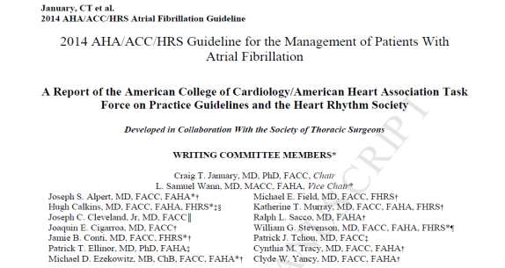
2014 ACC/AHA/HRS Treatment Guidelines to Prevent Thromboembolism in Patients with AF
Assess stroke risk with CHA₂DS₂-VASc score
Score 1: Annual stroke risk 1%, oral anticoagulants or aspirin may be considered
Score ≥2: Annual stroke risk 2%-15%, oral anticoagulants are recommended
Balance benefit vs. bleeding risk
2014 AHA/ACC/HRS Guideline for the Management of Patients with AF
CHA₂DS₂ VASc Score | Recommendation
0 | No anticoagulant
1 | Aspirin (81-325 mg daily) or warfarin (INR 2-3)
≥2 | Oral anticoagulants are recommended (warfarin (INR 2-3), dabigatran, rivaroxaban or apixaban
January, CT. et al. 2014 AHA/ACC/HRS Guideline for the Management of Patients With Atrial Fibrillation. JACC. 2014; doi: 10.1016/j.jacc.2014.03.022

Slide 3
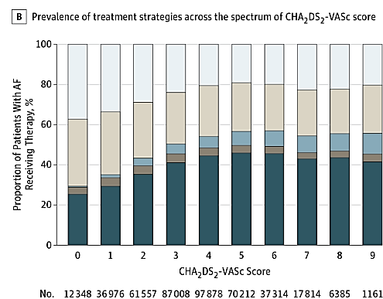
Oral Anticoagulation is Standard of Care, but Not Ideal for All
Use of OACs in AF Patients peaks at ~50%, use declines with increasing risk
Warfarin
Bleeding risk
Daily regimen
High non-adherence rates
Regular INR monitoring
Food and drug interaction issues
Complicates surgical procedures
Novel Oral Anticoagulants
Bleeding risk
Daily regimen
High non-adherence rates
Complicates surgical procedures
Lack of reversal agents
High cost
1. Hsu, J et al. JAMA Cardiol. Published online March 16, 2016. doi:10.1001/jamacardio.2015.0374

Slide 4
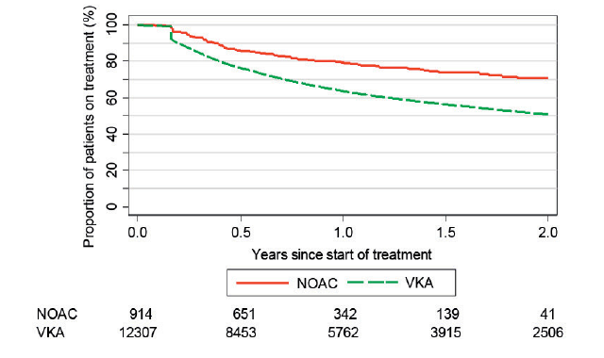
Despite NOAC Adoption and Ability to Switch NOACs, Adherence to Anticoagulation Remains a Challenge
~30% of NOAC patients stop taking any drug at 2 years
Source: Martinez C, et al. Therapy Persistence in Newly Diagnosed Non-Valvular Atrial Fibrillation Treated with Warfarin or NOAC. A Cohort Study. Thromb Haemost. 2015 Dec 22;115(1):31-9. doi: 10.1160/TH15-04-0350.

Slide 5
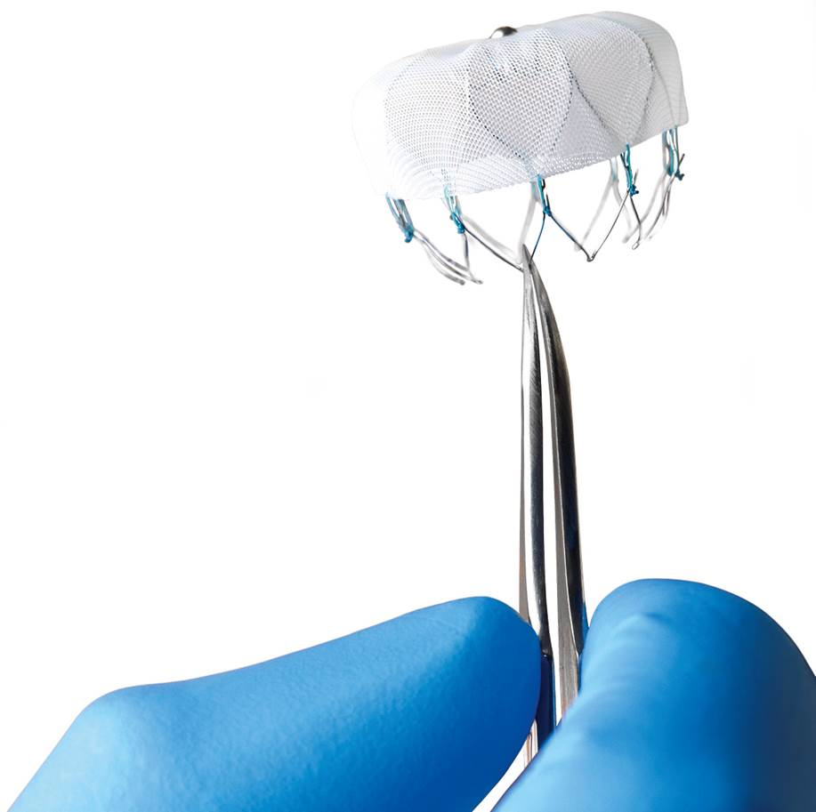
Introducing the WATCHMAN™ LAAC Device
A first-of-its-kind, proven alternative to long-term warfarin therapy for stroke risk reduction in patients with non-valvular AF
Most studied LAAC therapy, only one proven with long-term data from randomized trials and multi-center registries
A safe alternative to long-term warfarin therapy which offers comparable stroke risk reduction and enables patients to stop taking warfarin
Reddy, V et al. JAMA 2014; Vol. 312, No. 19.
Reddy, V et al. Watchman I: First Report of the 5-Year PROTECT-AF and Extended PREVAIL Results. TCT 2014.

Slide 6
WATCHMAN Therapy Indications for Use
The WATCHMAN™ Device is indicated to reduce the risk of thromboembolism from the left atrial appendage in patients with non-valvular atrial fibrillation who:
Are at increased risk for stroke and systemic embolism based on CHADS₂ or CHA₂DS₂-VASc scores and are recommended for anticoagulation therapy;
Are deemed by their physicians to be suitable for warfarin; and
Have an appropriate rationale to seek a non-pharmacologic alternative to warfarin, taking into account the safety and effectiveness of the device compared to warfarin.

Slide 7
WATCHMAN Therapy National Coverage Determination Effective Feb. 8, 2016
CMS will cover percutaneous LAAC implants when specific criteria are met:
Eligible patients must have a CHADS₂ score ≥ 2 or a CHA₂DS₂-VASc score ≥ 3
Patients must be suitable for short-term warfarin, but deemed unable to take long-term oral anticoagulation
Documented evidence of a formal shared decision interaction between the patient and an independent non-interventional physician using an OAC evidence-based decision tool
LAA Registry: Patients must be enrolled in a prospective national registry
Operator requirements: IC or EP or cardiovascular surgeon must have performed at least 25 transseptal punctures (TSP) through intact septum
Must maintain at least 25 TSP over a two year period (at least 12 are LAAC)
Facility Requirements: The procedure must be furnished in a hospital with an established structural heart disease (SHD) and/or electrophysiology (EP) program
Documented in medical record

Slide 8
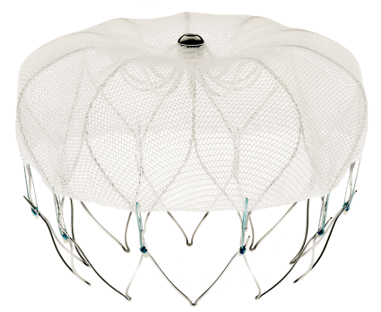
WATCHMAN™ LAAC Closure Device
Minimally Invasive, Local Solution
Available sizes: 21, 24, 27, 30, 33 mm diameter
Intra-LAA design
Avoids contact with left atrial wall to help prevent complications
Nitinol Frame
Conforms to unique anatomy of the LAA to reduce embolization risk
10 active fixation anchors - designed to engage tissue for stability
Proximal Face
Minimizes surface area facing the left atrium to reduce post-implant thrombus formation
160 micron membrane PET cap designed to block emboli and promote healing
Warfarin Cessation
92% after 45 days, >99% after 12 months¹
95% implant success rate¹
160 Micron Membrane
Anchors
1. Holmes, DR et al. JACC 2014; Vol. 64, No. 1

Slide 9
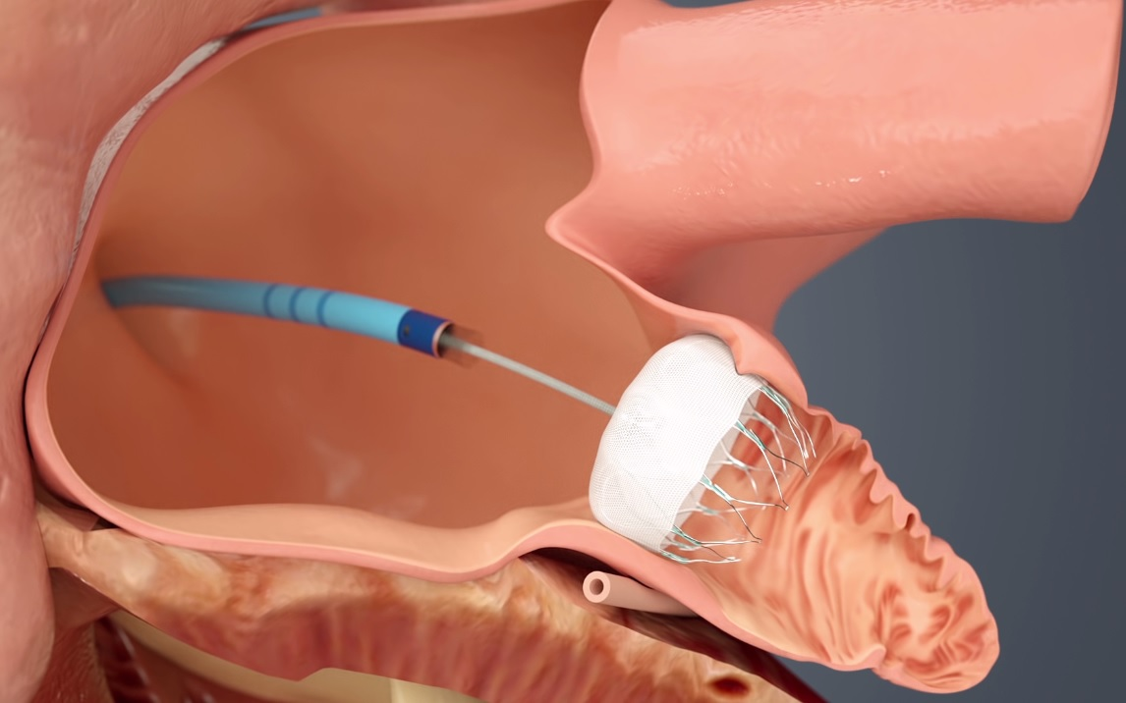
WATCHMAN™ Left Atrial Appendage Closure (LAAC) Device Procedure
One-time implant that does not need to be replaced
Performed in a cardiac cath lab/EP suite, does not need hybrid OR
Performed by a Heart Team
IC/EP or IC&EP, TEE, General Anesthesia, Surgical Back- up, WATCHMAN Clinical Specialist
Transfemoral Access: Catheter advanced to the LAA via the femoral vein (Does not require open heart surgery)
General anesthesia*
1 hour procedure*
1-2 day hospital stay*
* Typical to patient treatment in U.S. clinical trials

Slide 10
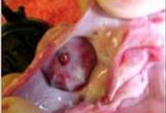
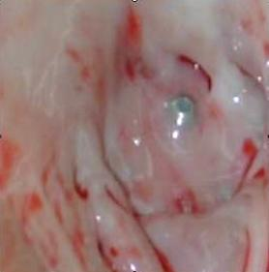
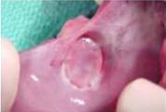
WATCHMAN™ Device Endothelialization
Canine Model – 30 Day
Canine Model – 45 Day
Human Pathology - 9 Months Post-implant
(Non-device related death)
Images on file at Boston Scientific Corporation.
Results in animal models may not necessarily be indicative of clinical outcomes.

Slide 11
WATCHMAN™ Clinical Leadership
WATCHMAN is a safe alternative to long-term warfarin therapy which offers comparable stroke risk reduction and enables patients to stop taking warfarin^{1,2,3}
95% implant success rate^{1,2,3}
1.5% procedural complication rate⁴
>92% warfarin cessation after 45 days, >99% after 1 year¹
WATCHMAN therapy demonstrated comparable stroke risk reduction and statistically significant reductions in disabling/fatal strokes, major non-procedure related bleeding and mortality compared to warfarin^{5,6}:
55% reduction in disabling/fatal stroke, largely driven by⁵
80% reduction in hemorrhagic stroke⁵
72% reduction in major non-procedure related bleeding⁶
27% reduction in all-cause mortality, largely driven by⁵
41% reduction in CV/unexplained mortality⁵
1. Holmes, DR et al. JACC 2014; 64(1). 2. Reddy VY, Holmes DR, et al. JACC 2016; 69(3): 253-261. 3. Boersma LVA, et al. Heart Rhythm 2017; 14(9): 1302-1308. 4. Varosy P et al. JACC 2018; 71(11): A320. 5. Reddy VY et al. JACC. 2017; 70(24): 2964-2975. 6. Price, M. J., V. Y. Reddy, et al. JACC: CV Interv 2015; 8(15).

Slide 12
WATCHMAN Clinical Data
Procedural Success and Safety

Slide 13
WATCHMAN: Most Studied LAAC Device Only one proven with long-term data from randomized trials and multi-center registries
Key Trials | N | Highlights
PROTECT AF¹ (2005-2008) | 707 | Prospective, randomized 2:1, non-inferiority trial of LAA closure vs. warfarin.
CAP² (2008-2010) | 566 | Prospective registry allowing continued access to the WATCHMAN Device and gain further information prior to PMA approval.
PREVAIL³ (2010-2012) | 407 | Prospective, randomized 2:1, non-inferiority trial to collect additional information on the WATCHMAN Device.
CAP2 (2012-2014) | 579 | Prospective registry allowing continued access to the WATCHMAN Device prior to PMA approval.
EWOLUTION (2013-2015)^{4*} | 1025 | Prospective registry allowing all patients receiving a WATCHMAN Device at participating centers in Europe, Middle East and Russia
Total patients | >3,000 | ~9,000 Patient-Years of Follow-up
* Majority of patients enrolled could not take anticoagulation and therefore contraindicated in the US per current labeling.
1 Reddy, et al. JAMA. 2014 ;312(19): 1988-1998.
2 Reddy VY et al. Circulation. 2011; 123:417-424.
3 Holmes et al., JACC 2014,;4(1): 1-11.
4 Boersma, L. V. A., et al. CCI (2015); 88(3): 460-465.
Notes:
WATCHMAN is the most studied LAAC device - most patients and only one with long-term clinical data.
Protect AF was prospective, randomized, multicenter trial with 707 patients studying the device versus warfarin.
Cap was a prospective continued access registry collecting additional data on device patients while awaiting approval
Prevail was the 2nd prospective, randomized trial versus warfarin to collect additional device data
Cap2 was another prospective continued access registry after Prevail.
Portfolio of over 2000 patients studied with over 6000 patient years of follow-up
3 positive votes from FDA sponsored panels
[CLICK]

Slide 14
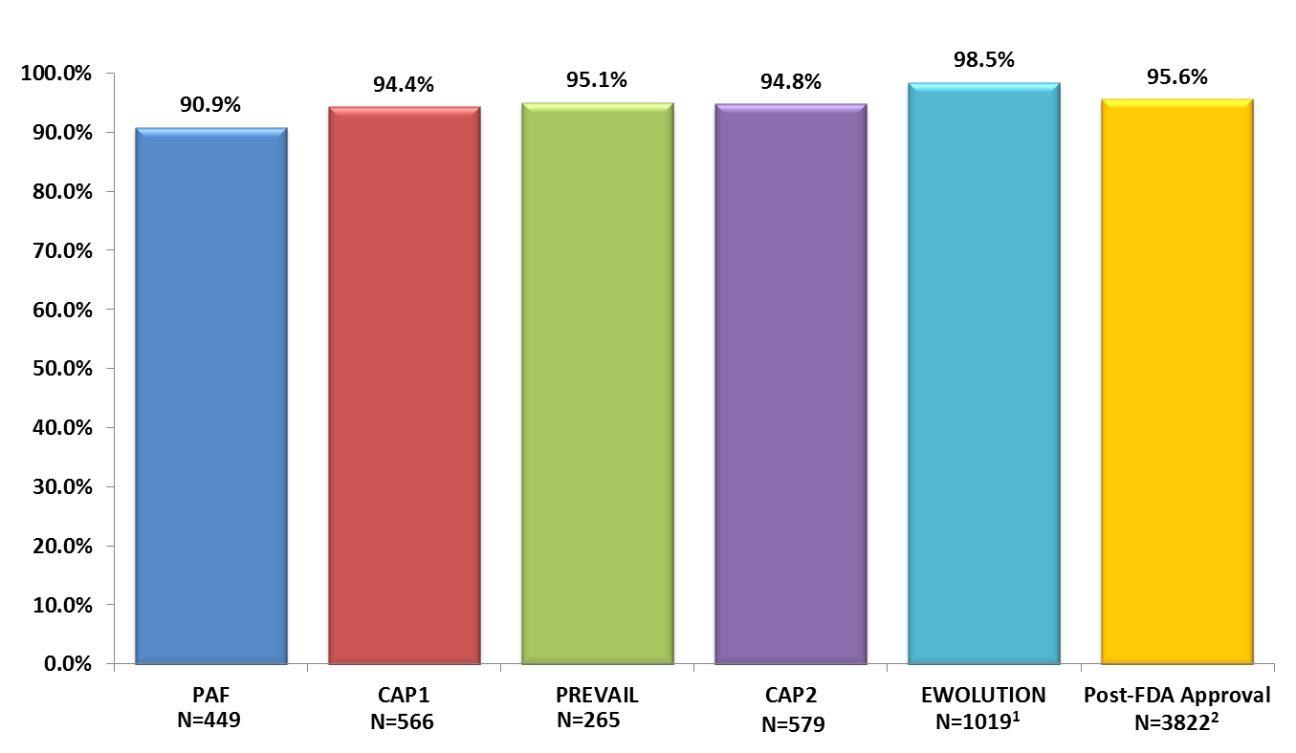
Procedural Success
~50% new operators
~70% new operators
Implant success defined as deployment and release of the device into the LAA; no leak ≥ 5 mm
* The EWOLUTION Registry is a European prospective registry which reflects CE Mark indications for use which differ from the FDA indications for use.
1 Boersma, L. V. A., B. Schmidt, et al. EHJ 2016; 37(31): 2465. 2. Reddy, V. Y., D. N. Gibson, et al. JACC 2016; 69(3): 253-261

Slide 15
Favorable Procedural Safety Profile: All Device and/or Procedure-related Serious Adverse Events within 7 Days
~50% New Operators in PREVAIL
N=232 | N=231 | N=566 | N=269 | N=579 | N=1019¹
* The EWOLUTION Registry is a European prospective registry which reflects CE Mark indications for use which differ from the FDA indications for use.
1 Boersma, L. V. A., B. Schmidt, et al. EHJ 2016; 37(31): 2465. 2. Reddy, V. Y., D. N. Gibson, et al. JACC 2016; 69(3): 253-261
Notes:
The pre-specified safety definitions across the trials differed. So they could be compared, we used a broad definition that included all procedural events in each trial.
Beyond the first half of PREVAIL, safety event rates are low and comparable to other procedures performed in the LA like AF ablation
Procedure complication rates continued to improve with each trial
Especially important, because 50% of the operators in Prevail had no prior experience with LAA closure.

Slide 16
Favorable Procedural Safety Profile: Major Procedural Complications Across WATCHMAN Studies
Clinical Trial Experience
Post Approval Experience
CAP (N=566)
CAP2 (N=579)
PREVAIL (N=269)
PROTECT AF (N=463)
EWOLUTION (N=1021)
U.S. Cohort (N=3822)
* The EWOLUTION Registry is a European prospective registry which reflects CE Mark indications for use which differ from the FDA indications for use.
Source: Reddy VY, Holmes DR, et al. JACC 2016; 69(3): 253-261.

Slide 17
Favorable Procedural Safety Profile: Major Procedural Complications Across WATCHMAN Studies
 | PROTECT-AF | PREVAIL | CAP | CAP2 | EWOLUTION | Post-FDA Approval | Aggregate Data
Pericardial Tamponade | 20 (4.3%) | 5 (1.9%) | 8 (1.4%) | 11 (1.9%) | 3 (0.29%) | 39 (1.02%) | 86 (1.28%)
Treated with pericardiocentesis | 13 (2.8%) | 4 (1.5%) | 7 (1.2%) | n/a | 2 (0.20%) | 24 (0.63%)
Treated surgically | 7 (1.5%) | 1 (0.4%) | 1 (0.2%) | n/a | 1 (0.10%) | 12 (0.31%)
Resulted in death | 0 | 0 | 0 | 0 | 0 | 3 (0.78%)
Pericardial effusion – no intervention | 4 (0.9%) | 0 | 5 (0.9%) | 3 (0.5%) | 4 (0.39%) | 11 (0.29%) | 27 (0.40%)
Procedure-related stroke | 5 (1.15%) | 1 (0.37%) | 0 | 2 (0.35%) | 1 (0.10%) | 3 (0.078%) | 12 (0.18%)
Device embolization | 3 (0.6%) | 2 (0.7%) | 1 (0.2%) | 0 | 2 (0.20%) | 9 (0.24%) | 17 (0.25%)
Removed percutaneously | 1 | 0 | 0 | 0 | 1 | 3
Removed surgically | 2 | 2 | 1 | 0 | 1 | 6
Death
Procedure-related mortality | 0 | 0 | 0 | 0 | 1 (0.1%) | 3 (0.078%) | 4 (0.06%)
Additional mortality within 7 days | 0 | 0 | 0 | 1 (0.17%) | 3 (0.29%) | 1 (0.026%) | 5 (0.07%)
* The EWOLUTION Registry is a European prospective registry which reflects CE Mark indications for use which differ from the FDA indications for use.
Source: Reddy VY, Holmes DR, et al. JACC 2016; 69(3): 253-261.

Slide 18
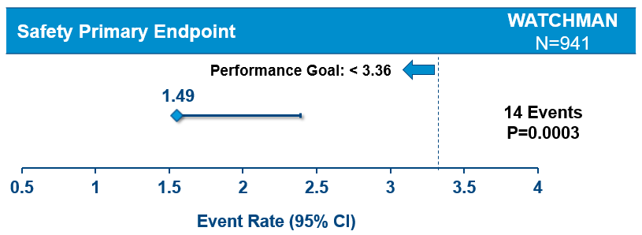
Real World Data: NESTed PAS (LAAO Registry) Major Procedural Complications within 7 Days
 | PROTECT AF N=707 | PREVAIL N=407 | CAP N=566 | CAP2 N-579 | EWOLUTION N=1014 | NESTed PAS N=979
Age (yrs) | 72±8.9 | 74.3±7.4 | 74.0±8.3 | 75.3±8.0 | 73±9 | 76.6±8.1
Male (%) | 70.3 | 70 | 65.5 | 61.0 | 59.9 | 61.3
CHADS₂ | 2.2 ± 1.2 | 2.4 ± 1.2 | 2.6 ± 1.0 | 2.7 ± 1.1 | 2.8 ± 1.3 | 3.2 ± 1.3
CHA₂DS₂-VASc | 3.4 ± 1.5 | 3.9 ± 1.5 | 4.0 ± 1.1 | 4.5 ± 1.3 | 4.5 ± 1.6 | 5.0 ± 1.4
HAS-BLED | n/a | n/a | n/a | n/a | 2.4 ± 1.2 | 2.7 ± 1.0
Primary composite safety endpoint: death, ischemic stroke, systemic embolism, or device/procedure-related events necessitating cardiac surgery or major endovascular intervention within either 7-days post-implant or hospital discharge, whichever occurred later.
Varosy P et al. JACC 2018; 71(11): A320.

Slide 19
WATCHMAN Clinical Data
Stroke Risk and Bleeding Reduction

Slide 20
Patient Level Meta-Analysis PROTECT AF, PREVAIL 5 Years
 | HR | p-value
Efficacy | 0.82 | 0.3
All stroke or SE | 0.96 | 0.9
Ischemic stroke or SE | 1.7 | 0.08
Hemorrhagic stroke | 0.2 | 0.0022
Ischemic stroke or SE >7 days | 1.4 | 0.3
Disabling/Fatal Stroke (MRS change of ≥2) | 0.45 | 0.03
Non-Disabling Stroke | 1.38 | 0.35
CV/unexplained death | 0.59 | 0.03
All-cause death | 0.73 | 0.04
Major bleed, all | 0.91 | 0.6
Major bleeding, non procedure-related | 0.48 | 0.0003
Source: . Reddy VY, Doshi SK, Kar S, et al. 5-Year Outcomes After Left Atrial Appendage Closure: From the PREVAIL and PROTECT AF Trials. JACC 2017; 70(24): 2964-2975.
Favors WATCHMAN ←
→ Favors warfarin
Hazard Ratio (95% CI)

Slide 21
WATCHMAN Comparable to Warfarin for Ischemic Stroke
Untreated AF
Treated with Warfarin
WATCHMAN Arm
Ischemic Stroke Risk (events per 100 pt-yrs)
CAP2
WASP
PREVAIL
PROTECT AF
EWOLUTION
CAP
Baseline CHA₂DS₂-VASc Score
Reddy VY, Doshi SK, Kar S, et al. JACC 2017; 70(24): 2964-2975.
Notes:
Central Illustration: Stroke Prevention in Non-valvular Atrial Fibrillation with LAA Closure. (Lower Panel) The ischemic stroke rates of non-valvular atrial fibrillation patients who are either untreated (dotted line) or treated with warfarin (solid line) are shown as a function of the baseline CHA₂DS₂-VASc score using two large population databases.^{12,13} On this graph, the ischemic stroke rates and 95% confidence intervals of the LAAC arms from various clinical trials are shown. Because the baseline CHA₂DS₂-VASc scores for CAP and WASP were identical, they are arbitrarily offset for clarity; CAP2 and EWOLUTION were similarly offset for clarity. This imputed placebo analysis demonstrates the consistent performance of LAA closure with the Watchman device in preventing ischemic stroke across the various clinical studies.
CI = confidence interval; HR = hazard ratio; SE = systemic embolism; CV = cardiovascular; LAA = left atrial appendage; CAP = Continued Access to PROTECT AF registry; CAP2 = Continued Access to PREVAIL;
EWOLUTION = Registry on Watchman Outcomes in Real-Life Utilization; WASP = Registry on WATCHMAN Outcomes in Real-Life Utilization WASP Registry.

Slide 22
WATCHMAN Significant Reduction in Disabling Strokes (Patient-Level Meta-Analysis)
Disabling/Fatal Strokes
Non-Disabling Strokes
55% Lower
Source: . Reddy VY, Doshi SK, Kar S, et al. 5-Year Outcomes After Left Atrial Appendage Closure: From the PREVAIL and PROTECT AF Trials. JACC 2017; 70(24): 2964-2975.
HR 0.45 (0.21 – 0.94)
P=0.03
Disabling Stroke defined as MRS ≥2
Two strokes in PREVAIL are excluded because the baseline MRS score was unavailable

Slide 23
Observed Rates of Major Bleeding Over Time According to Treatment Group
Post Procedure Therapy
Destination Therapy
Warfarin + ASA
(81mg) daily
Clopidogrel (75mg) + ASA (325 mg) daily
ASA (325mg) daily
Implant
45 days*
6 months
*if leak >5mm, patients remained on warfarin + ASA until seal documented, skipping the clopidogrel + ASA pharmacotherapy
 | LAAC (n=732) |  | Long-term warfarin (n=382) |  | Rate Ratio | P value
 | Bleeding Rate (n events / N at risk) | Event Rate per 100 pt-yrs (n events / N at risk) | Bleeding Rate (n events/N at risk) | Event Rate per 100 pt-yrs (n events / N at risk)
Overall | 10.8 (79/732) | 3.5 (79/2268) | 11.3 (43/382) | 3.6 (43/1187) | 0.96 | 0.84
Post Procedure | 5.9 (40/682) | 1.8 (40/2255) | 11.3 (43/381) | 3.6 (43/1180) | 0.49 | 0.001
Destination | 3.2 (19/601) | 1.0 (19/1958 | 9.7 (35/360) | 3.5 (35/1004) | 0.28 | <0.001
Overall period defined as after randomization to the end of follow-up; post-procedural period as >7 days after randomization to the end of follow-up; destination therapy period as beyond 180 days post-randomization, when patients assigned to LAA closure were eligible to receive aspirin alone.
Price, M. J., V. Y. Reddy, et al. JACC: CV Interv 2015; 8(15): 1925-1932

Slide 24
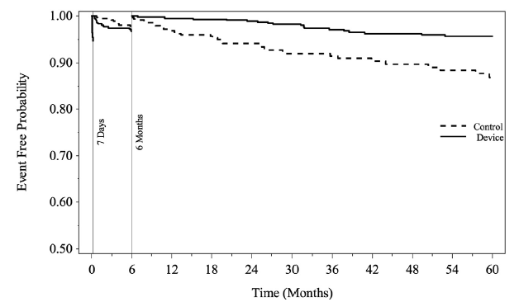
Bleeding Outcomes after Left Atrial Appendage Closure Compared with Long-term Warfarin
Freedom of Major Bleeding Over 3 Adjunctive Pharmacotherapy Intervals
72%
>6 months post-procedure
p < 0.001
Price, M. J., V. Y. Reddy, et al. JACC: CV Interv 2015; 8(15): 1925-1932

Slide 25
WATCHMAN is the Most Studied LAAC Device with Long-term Clinical Data
 | Results
Safety | WATCHMAN procedure is safe | 95% implant success; ~1.5% complication rates¹
Primary Efficacy | WATCHMAN comparable to warfarin | 18% reduction in events (p=0.27)²
Stroke | WATCHMAN comparable to warfarin | 55% reduction in disabling/fatal stroke (p=0.03)*, largely driven by 80% reduction in hemorrhagic stroke (p=0.003)²
Mortality | WATCHMAN statistically significant to warfarin | 27% reduction in all-cause mortality (p=0.04)² 41% reduction in CV/unexplained mortality (p=0.03)²
Major Bleeding | WATCHMAN statistically significant to warfarin post-procedure | 72% reduction after 6-months (p=0.001)³
Warfarin Cessation | WATCHMAN allows the majority of patients to discontinue warfarin | 92% of patients discontinue after 45-days; 99% of patients discontinue after 1 year⁴
1. Varosy P et al. JACC 2018; 71(11): A320. 2. Reddy VY et al. JACC. 2017; 70(24): 2964-2975; 3. Price, M. J., V. Y. Reddy, et al. JACC: CV Interv 2015; 8(15): 1925-1932; 4. Holmes, DR et al. JACC 2014; 64(1): 1-12; 6.

Slide 26
Questions?

Slide 27
WATCHMAN Clinical Data
Future Patient Populations* and Device and Delivery System Generations
* Data presented is in patients primarily contraindicated for LAAC with WATCHMAN in the United States.

Slide 28
WATCHMAN FLX™ : Designed to Broaden Treatment Matrix and Improve Ease of Use
Designed for greatly enhanced stability and ease-of-use
Designed for greater apposition to appendage wall
New anchor design, additional anchors and reduced main body taper
Anticipate starting EU and U.S. clinical trials mid-year 2018
Caution: WATCHMAN FLX is an Investigational Device. Limited by Federal (or US) law to investigational use only. Not available for sale.

Slide 29
ASAP-TOO (NCT02928497): Overview
Study Objective | Evaluate LAA Closure with WATCHMAN in NVAF patients deemed not suitable for oral anti-coagulation therapy
Study Design | Prospective, multi-center Randomized 2:1 (Watchman vs Control)
Primary Endpoint | Effectiveness Endpoint Time to first occurrence of ischemic stroke or systemic embolism Safety Endpoint 7-day rate of all-cause death, ischemic stroke, systemic embolism, or device- or procedure- related events requiring open cardiac surgery or major endovascular intervention
Patient Population | 888
Number of Sites | 100 global sites
Follow-up* | 3 month with TEE 6,18 month phone visit 12 month with TEE Bi-annually for years 2-5
Brain imaging required at baseline if prior stroke or TIA
Holmes et al. AHJ 2017; 189: 68-74.
Notes:
29

Slide 30
ASAP-TOO Device Group Medication Therapy
Visit Interval | Aspirin | Clopidogrel*
Discharge through 3-month visit | Yes, suggested dose: 75-100mg | Yes Suggested dose: 75mg
3-month visit through 12-month visit | Yes, suggested dose: 75-100mg | No, unless other indication
Following the 12-month visit | No, unless other indication | No, unless other indication
*Clopidogrel may be substituted with ticagrelor or prasugrel if the subject requires the medication for other indications (e.g. acute coronary syndromes treated with drug eluting stents) or if the subject has a known resistance to clopidogrel.
**Patients are allowed to be on dual antiplatelet therapy (outside of the protocol required 3- months period) if indicated due to a condition other than WATCHMAN implantation.
*Clopidogrel may be substituted with ticagrelor or prasugrel if the subject requires the medication for other indications (e.g. acute coronary syndromes treated with drug eluting stents) or if the subject has a known resistance to clopidogrel.
**Patients are allowed to be on dual antiplatelet therapy (outside of the protocol required 3- months period) if indicated due to a condition other than WATCHMAN implantation.
Holmes et al. AHJ 2017; 189: 68-74.

Slide 31
Coming in the next few years?

